Slide 1

Optimization Basics
Computational Optimization
Instructor: Fengqi You
Cornell University

Slide 2
Outline
Basic concepts in optimization
  Objective function, constraints, variables, feasible region
  Graphic solution
  Convexity of functions and sets
Analytical solution of unconstrained optimization problems
  Example: Maximum likelihood estimation in Bayesian learning
Numerical solution of unconstrained multivariate optimization
  Example on convex optimization: Linear regression
  Example on nonconvex case: Logistic regression
Overview of types of optimization problems

Slide 3
General Optimization Problem
Mimimize/Maximize f (x)
Subject to (“s.t.”) g (x) ≤ 0
x ∈ X
where
x = vector of variables
f = objective function
g = constraints
X = set of bounds/integrality constraints

Slide 4
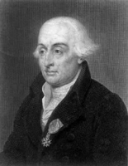
Classic Optimization
Newton (1664)
Leibniz (1673)
Lagrange (1778)
Solution of inequalities Fourier (1826)
Solution of linear equations Gauss (1826)
Solution of inequality systems Farkas (1902)

Slide 5
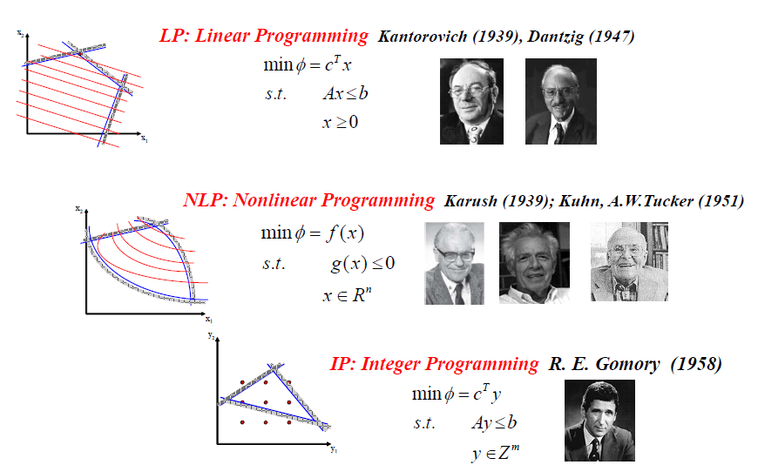
Modern Optimization

Slide 6
Linear Programming Example
Decision Variables e.g., x and y :
  There are quantities you can control to improve your objective
Constraints e.g., 5x + 8y ≤ 24 , x ≥ 0 , y ≥ 0
  Limitations on the values of the decision variables.
Objective Function e.g., 3x + 4y
  Value measure used to rank alternatives
  Seek to maximize or minimize this objective

Slide 7
Linear Programming Example
A feasible solution satisfies all of the constraints
x = 1, y = 1 is feasible; x = 1, y = 3 is infeasible
An optimal solution is the best feasible solution
The optimal solution is x = 4.8, y = 0

Slide 8
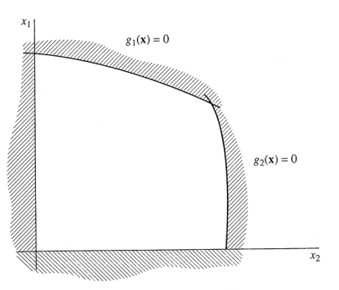
Basic Concepts
Feasible region
  Intersection of constraints AND operators
Optimality
Convexity
Number of degrees of freedom
  Number of variables minus number of independent equality constraints
  For a model h(x) = 0 h: R^{n}→R^{m}
    If n > m, then the degrees of freedom = n-m
    If n ≤ m, then no degrees of freedom

Slide 9
Reactor Network Design
k
1
k
3
k
2
k
4
A
B
C
A
B
C
A
A, B, C
A, B, C
C^{in}
=1
C
C
A
1
A
1
C
A
2
C
B
2
B
1
V
V
1
2
min
−
C
6 variables
4 equations
Degrees of freedom: 2
B
2
s.t.
C
−
1
+
k
C
V
=
0
A
1
1
A
1
1
C
−
C
+
k
C
V
=
0
A
2
A
1
2
A
2
2
C
+
C
−
1
+
k
C
V
=
0
B
1
A
1
3
B
1
1
C
−
C
+
C
−
C
+
k
C
V
=
0
B
2
B
1
A
2
A
1
4
B
2
2
V
0
.
5
+
V
0
.
5
≤
4
1
2
0
≤
(
C
,
C
,
C
,
C
,
V
,
V
)
≤
(
1
,
1
,
1
,
1
,
16
,
16
)
A
1
A
2
B
1
B
2
1
2

Slide 10
Heat Exchanger Network Synthesis
Energy balances introduce nonconvexities (conservation of flow * temperature)
H1 @ 300
f
3
f
7
t
1
t
2
f
1
H1 @ 320
f
5
C1 @ 100
C1 @ 280
F = 10
f
H2 @ 300
6
f
2
f
4
f
8
t
3
t
4
H2 @ 340

Slide 11
HENS Model
⎡
⎛
(
320
−
t
)
+
(
300
−
t
)
0
.
6
1200
800
2
.
5
2
/
3
(
320
−
t
)
(
300
−
t
)
+
2
1
⎞
⎤
+
min
⎢
⎝
2
1
⎠
⎥
⎣
6
⎦
⎡
⎛
(
340
−
t
)
+
(
300
−
t
)
0
.
6
1200
1000
0
.
2
2
/
3
(
340
−
t
)
(
300
−
t
)
+
4
3
⎞
⎤
⎢
⎝
4
3
⎠
⎥
⎣
6
⎦
s.t.
f
1
+
f
2
=
10
f
1
+
f
6
=
f
3
f
2
+
f
5
=
f
4
12 variables
9 equations
Degrees of freedom = 3
f
5
+
f
7
=
f
3
f
6
+
f
8
=
f
4
100
f
1
+
t
4
f
6
=
t
1
f
3
100
f
2
+
t
2
f
5
=
t
3
f
4
f
3
(
t
2
−
t
1
)
=
800
f
4
(
t
4
−
t
3
)
=
1000
t
0
≤
f
≤
10,
(100, 100, 100, 100) ≤
≤ (290, 310, 290, 330)

Slide 12
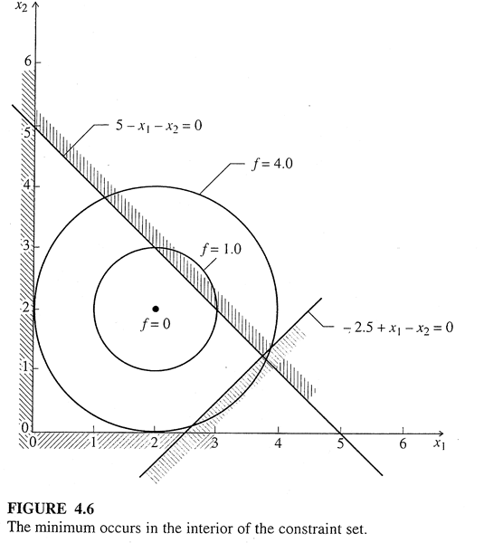
Example: Feasible Region and Optimality
Degrees of freedom ?

Slide 13
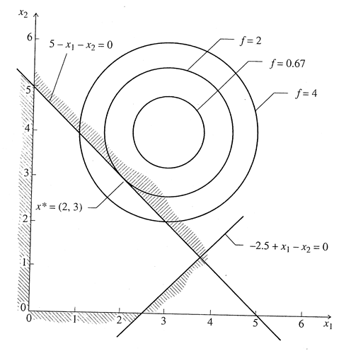
Example: Feasible Region and Optimality

Slide 14
Graphic Solution
Works for two- or three-variable optimization models
Plot elements of the model in a coordinate system corresponding to decision variables
  Points correspond to specific choices for decision variables
  Lines correspond to objective boundaries and objective function contours (lines of constant value)
  Identify moves (directions) in the plot that lead to improving objective function values while guaranteeing that all constraints are satisfied
Feasible region
  The collection of choices for decision variables satisfying all model constraints
Optimal solution
  A feasible choice with objective function at least equal to that of any other feasible solution

Slide 15
Remarks
min f(x) ⇔ max –f(x)
All the inequalities can be re-arranged as g(x)≤0
  e.g. x ≥ 0 ⇔ – x ≤ 0
  e.g. x₁ + x₂ ≥ 3 ⇔ – x₁ – x₂ + 3 ≤ 0
An equation can be treated as two inequalities
Optimization models usually do not use ‘<’ or ‘>’

Slide 16
Convex and Nonconvex Sets
A set is convex if, for every pair of points in the set, the line segment joining these two points belongs to the set
Convex Set
Nonconvex Set

Slide 17
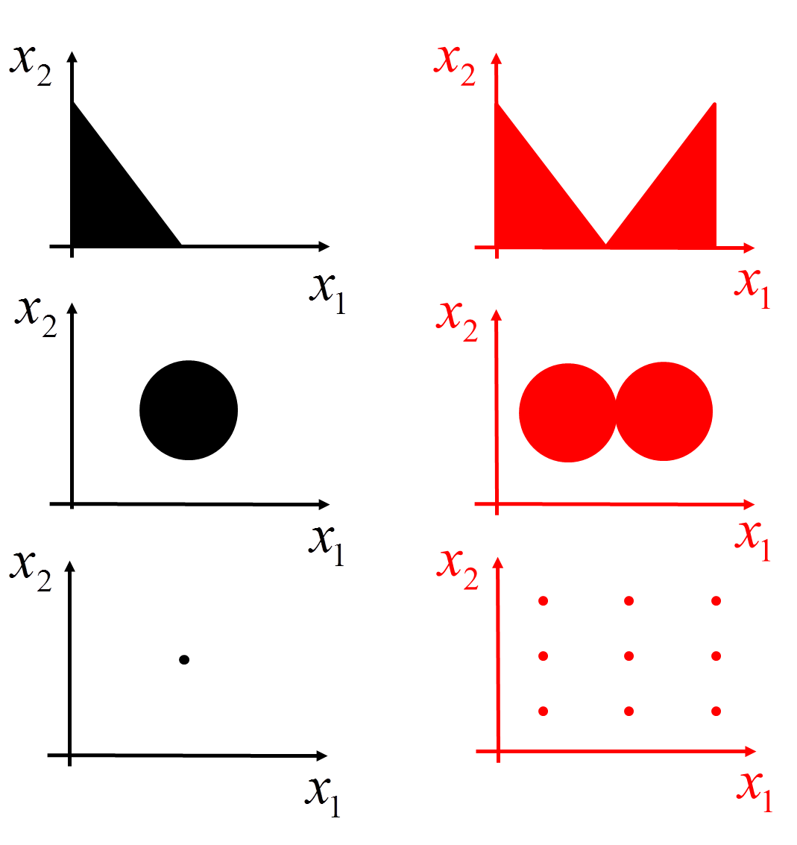
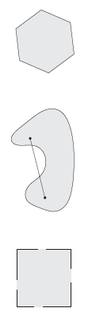
Which of the following are Convex Sets?

Slide 18
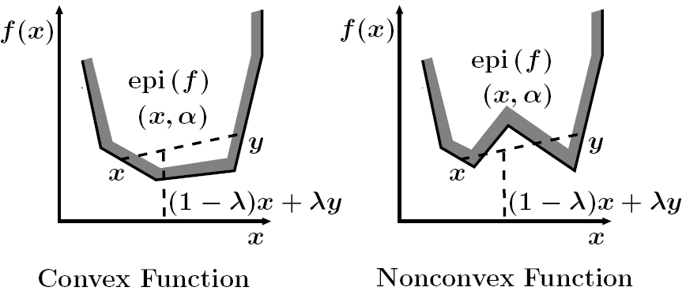
Convex and Nonconvex Functions
A function is convex if, for every pair of points in its domain, the line segment joining these two points is above the graph of the function
f(x) is concave if –f(x) is convex

Slide 19
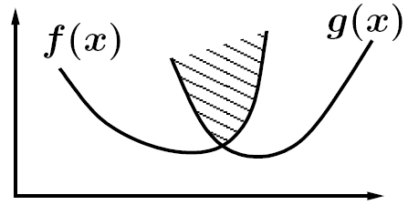
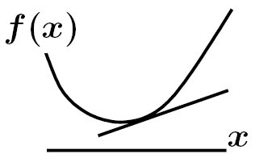
Properties of Convex Functions
Any positive combination of two convex functions is convex
The maximum of two convex functions is convex
All tangents of a differentiable convex function lie below the function

Slide 20
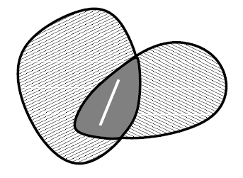
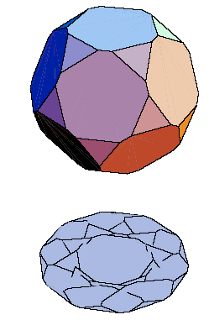
Properties of Convex Sets
The intersection of convex sets is convex
Linear transformations
such as projection
preserve convexity

Slide 21
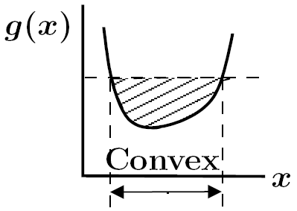
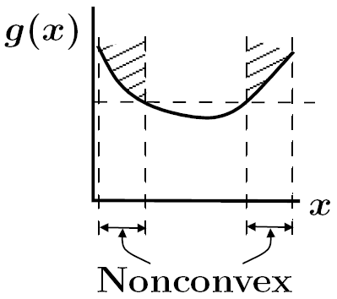
Convex Functions and Sets
The lower level set g(x)≤α
is convex if g(x) is a
convex function
The upper level set g(x)≥α
may be nonvonvex

Slide 22
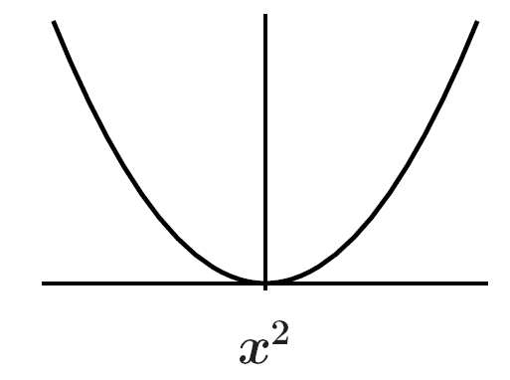
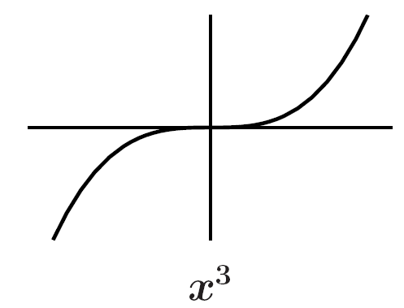
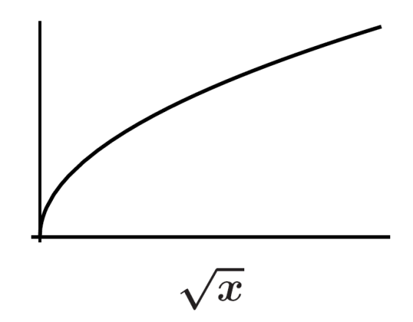
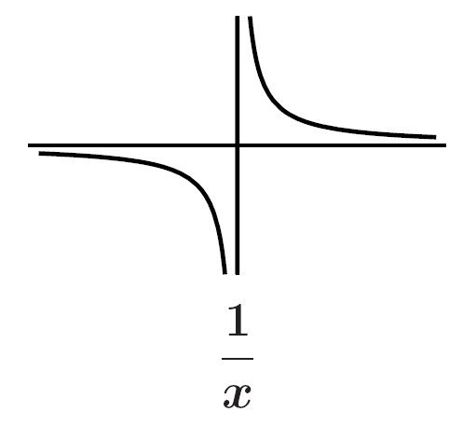
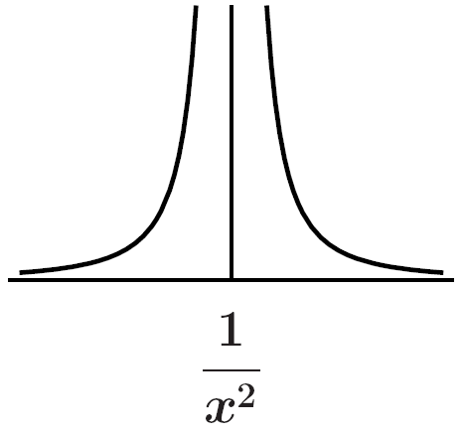
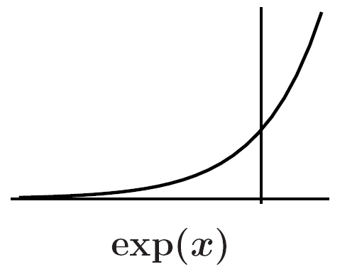
Common Functions in Modeling

Slide 23
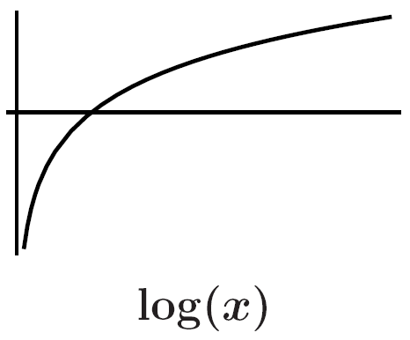
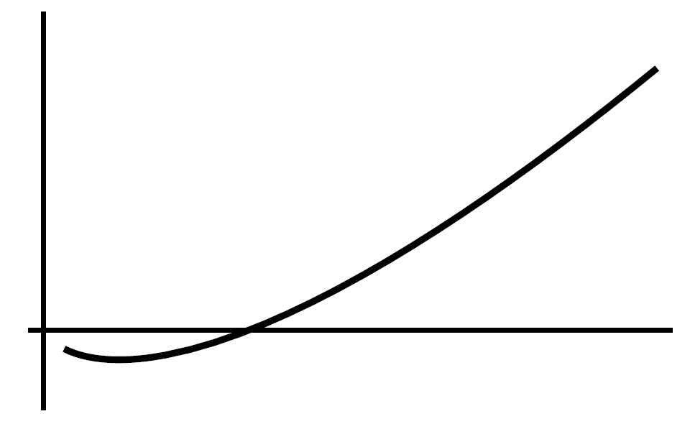

Common Functions in Modeling

Slide 24
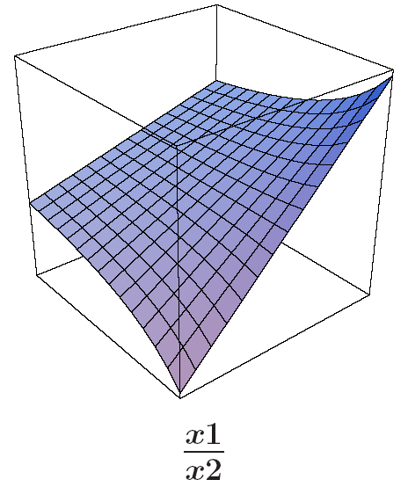
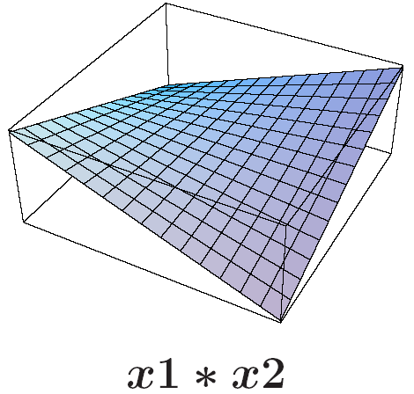
Common Functions in Modeling

Slide 25
General Optimization Problem
Objective
Equality constraints
Inequality constraints
Continuous variables
Discrete variables
Continuous optimization
  Linear programming: LP
  Nonlinear programming: NLP
Discrete optimization
  Mixed-integer linear programming: MILP
  Mixed-integer nonlinear programming: MINLP

Slide 26
Classification of Algebraic Optimization Problems
Linear Programming (LP)
  Linear optimization
  All functions (f, g) are linear
Nonlinear Programming (NLP)
  Some functions (f and/or g) are nonlinear
Integer Programming
  Some variables required to be integral
Mixed-integer Linear Programming (MILP)
  Mix integer and continuous variables, all functions are linear
Mixed-integer Nonlinear Programming (MINLP)
  Includes integer variables and nonlinear functions

Slide 27
Linear Programming
x₂
x₁
Objective function and all constraints are linear
Only continuous variables
Kantorovich (1939), Dantzig (1947), Karmarkar (1984)

Slide 28


Nonlinear Programming
x₂
x₁
Some functions are nonlinear
Only continuous variables
Karush (1939), Kuhn, Tucker (1951)
Saunders (1978), Powell (1977), Nocedal (1999), Biegler (2002)

Slide 29
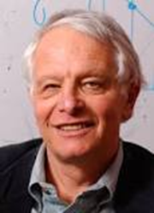
Mixed-Integer Linear Programming
x₂
x₁
Objective function and all constraints are linear
Some variables are continuous, and some are discrete/integer
Gomory (1958), Balas (1962), Dakin (1965), Nemhauser (1999)

Slide 30
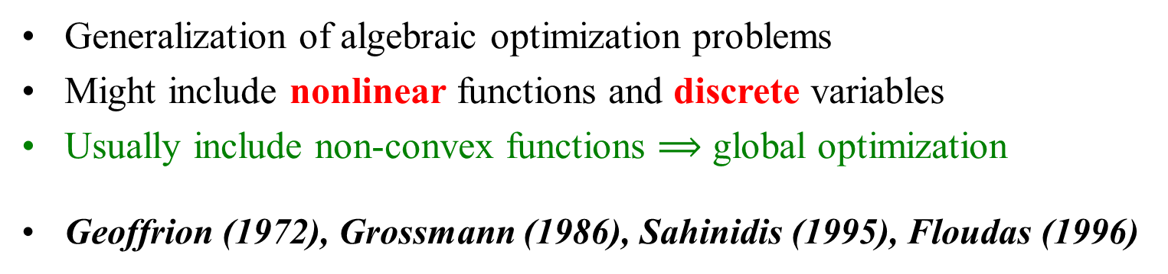
Mixed-Integer Nonlinear Programming
x₂
x₁
Generalization of algebraic optimization problems
Might include nonlinear functions and discrete variables
Usually include non-convex functions $⟹$ global optimization
Geoffrion (1972), Grossmann (1986), Sahinidis (1995), Floudas (1996)

Slide 31

Optimization under Uncertainty
Stochastic programming
  Birge (1997)
  Ruszczyński, Shapiro (2002)
Robust optimization
  Ben-Tal, Nemirovski (1998)
  Bertsimas (2004)

Slide 32
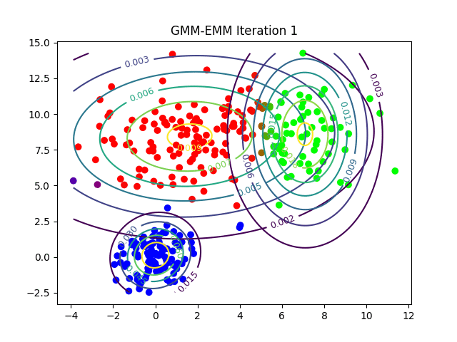
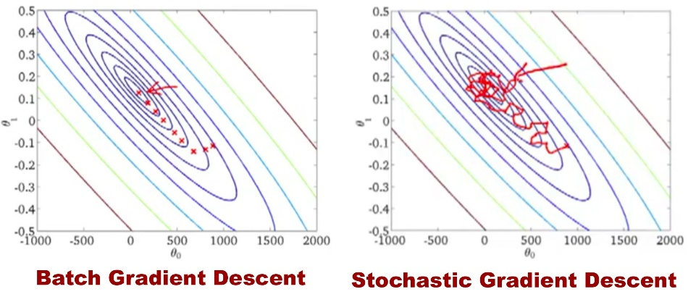
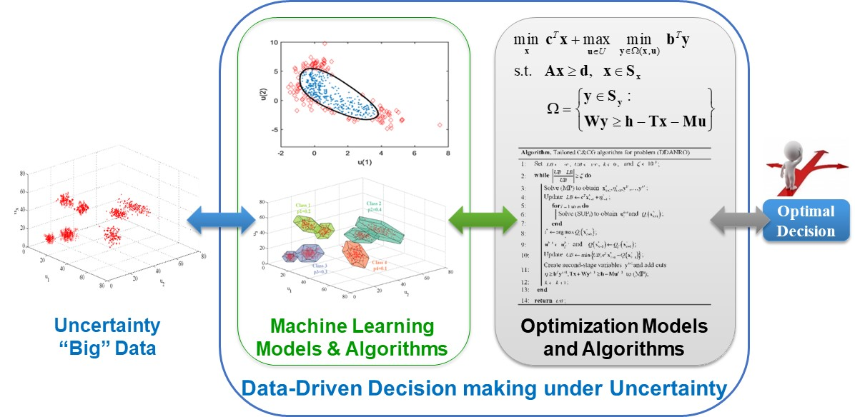
Optimization and Big Data Analytics
Optimization for machine learning
Data-driven decision-making under uncertainty

Slide 33
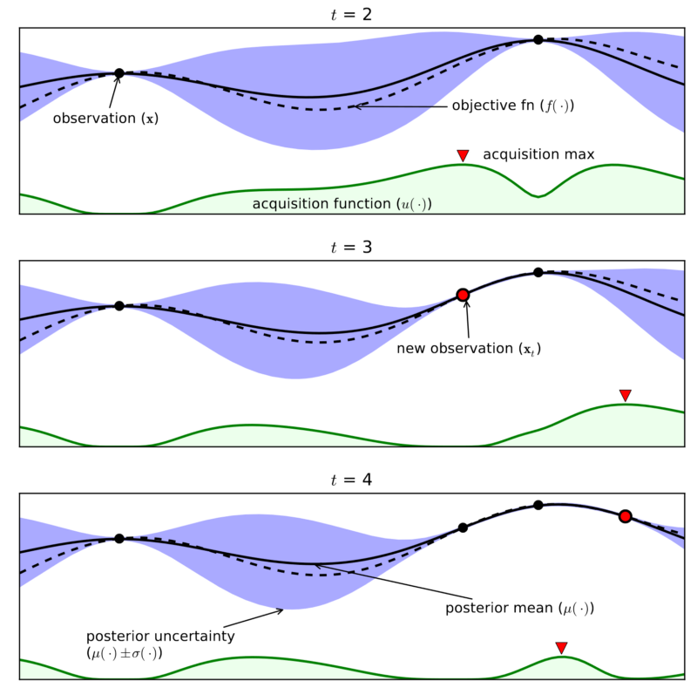
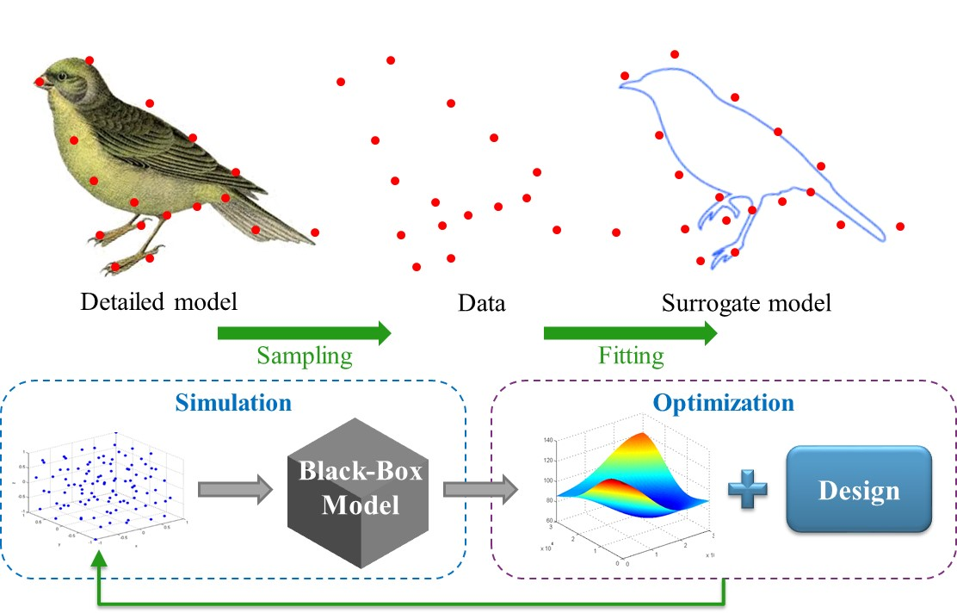
Optimization and Big Data Analytics
Surrogate-based optimization
  Simulation-based optimization
  Metamodel-based optimization
  Response surface methods/designs
  Black-box derivative-free optimization
Bayesian optimization
  Machine-learning-based derivative-free algorithms
  Increasing popularity in machine learning
  de Freitas (2010, 2016); Adams (2012)

