Slide 1

Introduction
Computational Optimization
Instructor: Fengqi You
Cornell University

Slide 2
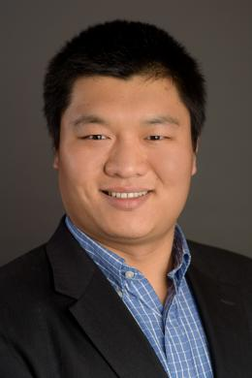
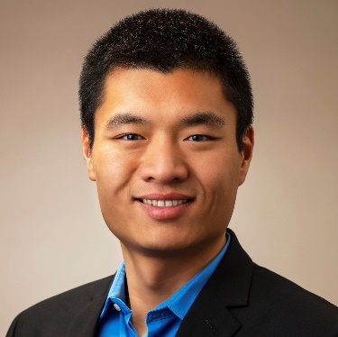



About Me – Fengqi You
Roxanne E. and Michael J. Zak Professor, Cornell University
  Computer Science
  Systems Engineering
  Applied Mathematics
  Mechanical Engineering
  Applied Information Science
  Electrical and Computer Engineering
  Civil and Environmental Engineering
  Chemical and Biomolecular Engineering
  Operations Research and Information Engineering
  Co-Director, Cornell University AI for Science Institute (CUAISci)
  Co-Director, Cornell Institute for Digital Agriculture (CIDA)
  Director, Cornell AI for Sustainability Initiative (CAISI)
Assistant Professor, Northwestern University, 2011-2016
Argonne Scholar, Argonne National Laboratory, 2009-2011
  Mathematics and Computer Science Division
  Decision and Information Science Division
  Energy Systems Division
Ph.D., Carnegie Mellon University, 2009

Slide 3
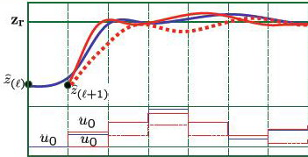
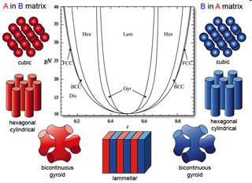
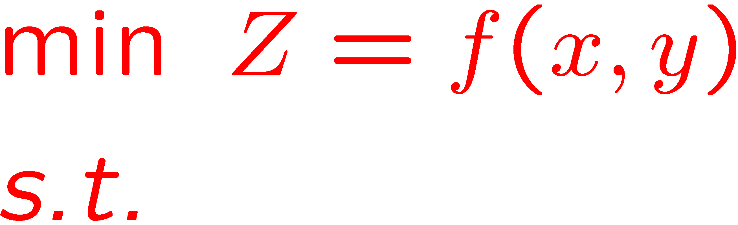
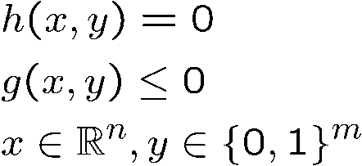
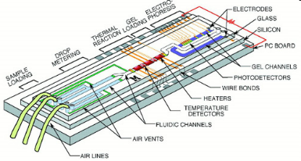
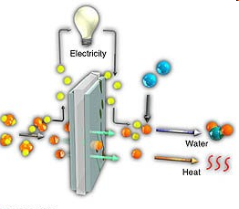
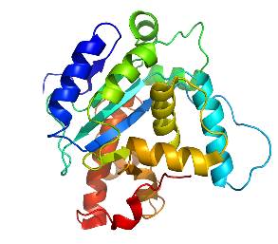
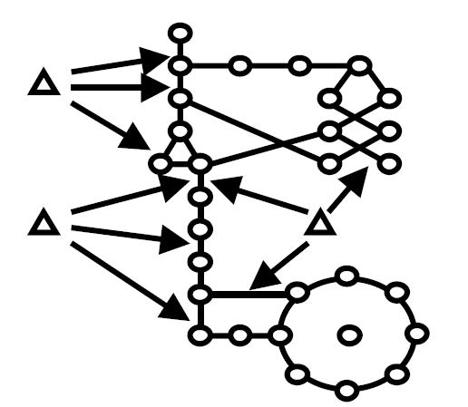
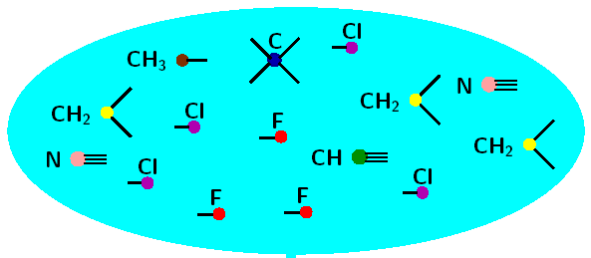
Optimization - Science of the Better
Dynamic Systems
Energy Systems
Microfluidics
Battery
Protein Structure
Network Systems
Product Design
Computational Optimization
Science: Computational and data-enabled tools for knowledge discovery
Engineering: Decision support and better/best design, operation & control
Big Data Analytics & Machine Learning: Core of the theory and algorithms

Slide 4
Optimization Applications
Manufacturing
  Floor shop scheduling
  Plan facility layout
  Process improvement
  Production control
Business & Economics
  Selecting investment portfolio
  Determine advertising strategy
  Sales and operations planning
  Game theory problems
Physical Sciences
  Chemical equilibrium
  Molecular structure prediction
Engineering Design
  Process design/synthesis (ChE)
  Shape optimization (ME)
  Structure optimization (CE)
  Fault diagnosis (SE)
  VLSI design (ECE)
Medicine
  Disease diagnosis
  Drug design
……
  You will have a chance to explore an optimization application that you are interested through the ‘Team Project’

Slide 5
The “Roadmap” of Machine Learning (T. Mitchell)
Computer Science
Domain Expertise
Machine Learning
Statistics
Optimization
Probability
Calculus
Measure
Theory
Linear Algebra

Slide 6
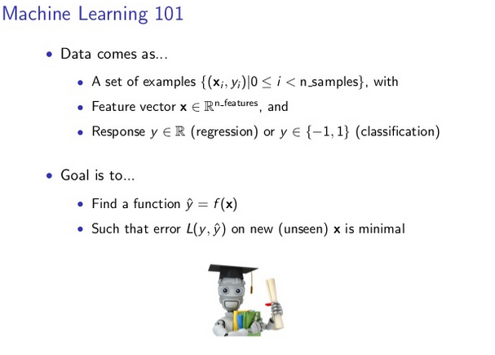
Machine Learning as An Optimization Problem
Material from Andrew Ng

Slide 7



What to expect from this course?
A balance between theory, computation, and applications
Optimization theory (30%)
  It’s NOT a math course, but has proofs as a branch of applied math
  Linear/ nonlinear/ integer/ global/ dynamic/ stochastic optimization
Computational algorithms and software (30%)
  It is NOT a programing course, but the focus is on ‘computational optimization’, i.e. using computational tools to solve problems
Applications (40%)
  (details on next page)

Slide 8
6800: Computational Optimization - Applications
Applications (40%)
  Refinery planning; flux balance analysis; multi-period optimization
  Synthesis of distillation sequences; reaction and conversion pathway/network analysis; scheduling of batch processes; capacity planning of chemical process networks; protein folding and secondary structure prediction
  Optimization of distillation column; gasoline blending optimization; parameter estimation;
  Design and synthesis of continuous processes; design of batch plants; supply chain design with inventory
  Agricultural production planning; inventory management; multistage portfolio selection; offshore oilfield development planning under uncertainty; stochastic unit commitment for electric power systems
  Robust planning of cancer treatment; portfolio optimization; robust planning of process network; robust design of energy systems
  Internet of Things enabled cybermanufacturing; quality control of batch manufacturing; process monitoring; in-silico screening of MOFs

Slide 9
Course Topics
Linear programming (HW)
Mixed-integer linear programming (HW)
Nonlinear optimization basics (HW)
Nonlinear programming (HW)
MINLP and deterministic global optimization (HW)
Stochastic programming
Robust optimization
Optimization and machine learning (last 2-3 weeks)
  A transition to SYSEN 5888/6888: Deep Learning (SP27)
A balance between theory, computation, and applications
(HW)

Slide 10
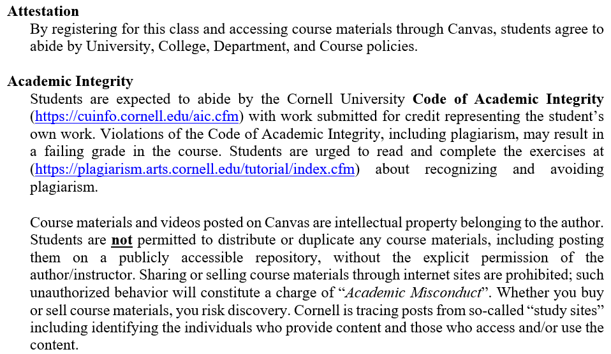
Syllabus

Slide 11
Diversity Statement
Every student in this course is expected to contribute to an inclusive and respectful class environment. It is my intent that students from all diverse backgrounds and perspectives be well-served by this course, that students’ learning needs to be addressed both in and out of class, and that the diversity that students bring to this class be viewed as a resource, strength and benefit. It is my intent to present materials and activities that are respectful of diversity: gender, sexual orientation, disability, age, socioeconomic status, ethnicity, race, culture, perspective, and other background characteristics. Civil discourse, reasoned thought, sustained discussion, and constructive engagement without degrading, abusing, harassing, or silencing others is required of all students in this class. Your suggestions about how to improve the value of diversity in this course are encouraged and appreciated. Please let me know ways to improve the effectiveness of the course for you personally or for other students or student groups.

Slide 12
What to Expect
Homework assignments
  Theory
  Computation
  Application
Team Project
  Theory
  Computation
  Application
A balance between theory, computation, and applications

Slide 13
Teams
The maximum size of a team is five (5) students; there is no problem at all to have only one member in a team.
  Team signup deadline: 9/30
Project: Any large-scale application topic of your interest
Each team needs to submit:
  A project plan
  Presentation slides and video
  A final project report

Slide 14
Team Dynamics
Every student in the same team gets the same score, regardless of the number of students per team.
We encourage students to work out team dynamics problems for themselves, but if you feel some members of the team are not contributing their share, you could choose to split the team into two (or more). It is unacceptable to complain about such problems and request grade adjustments after the assignments are due. We reserve the right to deal with dysfunctional teams in extreme ways, e.g., assigning individual students to be one-member teams.

Slide 15
Relevant Courses at Cornell and Comparison
This course (SysEn 6800) covers much wider spectrum of topics and more applications – breath v.s. depth
 | Course Title | Differences from the proposed course
ORIE 6300 | Mathematical Programming I | PhD level course focusing on the theory of linear programming.
ORIE 6310 | Mathematical Programming II | PhD level course focusing on the theory of continuous nonlinear programming.
ORIE 6334 | Combinatorial Optimization | PhD level course on approximate algorithms for integer and combinatorial optimization.
ORIE 6326 | Convex Optimization | PhD level course on convex, continuous optimization problems.
ORIE 3300/5300 | Optimization I | Undergraduate level linear programming and duality theory course, and on integer programming, dynamic programming, and network optimization.
ORIE 3310/5310 | Optimization II
ORIE 5370 | Optimization Modeling in Finance | Masters-level course on financial applications of optimization methods.
CS 5727 ORIE 5380 | Optimization Methods (Cornell Tech) | Limited to linear, integer and nonlinear optimization topics. Does not include MINLP, global optimization of non-convex problems, stochastic programming, robust optimization and data-driven optimization topics.
ORIE 5142 SYSEN 5200 | Systems Analysis Behavior and Optimization | Masters-level course for design, simulation, optimization, and control of complex systems. Does not cover sufficient theory or computation issues.
ORIE 3120 | Industrial Data and Systems Analysis | These are machine learning or data mining courses from ORIE and CS at various levels. They all focus on the theory and algorithms for data analysis. Although optimization is an important component for these courses, none of them touch optimization theory and only address optimization applications on data analysis.
ORIE 4740 | Statistical Data Mining I
ORIE 4741 | Learning with Big Messy Data
ORIE 6741 | Bayesian Machine Learning
ORIE 4742 | Information Theory, Probabilistic Modeling, & Deep Learning with Scientific & Financial Applications
CS 4786 | Machine Learning for Data Science
CS 5785 | Applied Machine Learning
CS 4780/5780 | Machine Learning for Intelligent Systems

Slide 16
Using AI Assistants
Where they help
  Writing and debugging Pyomo/GAMS code
  Explaining theory; looking up solvers and options
Where they fail — often, and confidently
  Dropped or mis-signed constraints; false convexity claims; incomplete KKT / duality
  Invalid “convexifications”; hallucinated solver options; a “global optimum” that isn’t
What this course builds
  Knowing enough theory to tell a correct optimization model from a confident wrong one

Slide 17
AI on Homework: Use It, Then Check It
Course policy
  Generative AI is not allowed on graded problems, except where a problem explicitly says so
Each homework ends with one required AI exercise (graded for completion)
  Solve it yourself → have an AI reproduce it → validate against your own answer
  Critique one “trap” problem, then reflect on what it got wrong
  Submit your prompts, the AI’s output, and your critique
The points
  Not the answer
  Learning where these tools break on optimization problems

Slide 18
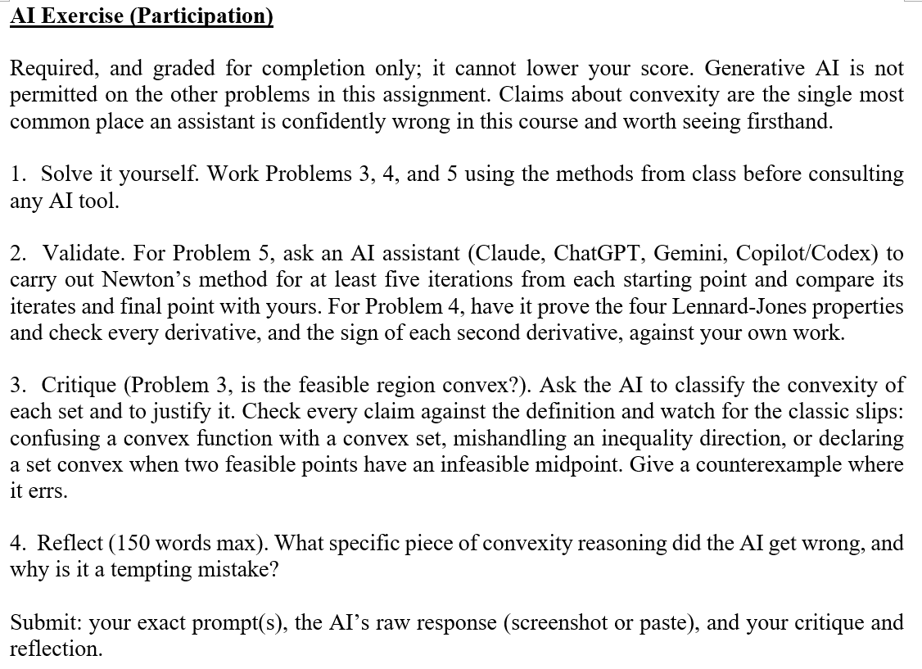
Example Problem in HW

Slide 19

Canvas and Ed Discussion
Canvas
  Canvas site opens on Sept. 9
  HW 1 due Sept. 23
Ed Discussion: https://edstem.org/us/courses/100322
  Most effective & responsive communication
  platform for addressing student queries
  Join link: https://edstem.org/us/join/mvKpFx
  →
Email: CDS-teach@cornell.edu
  For individual & non-technical inquiries only

Slide 20
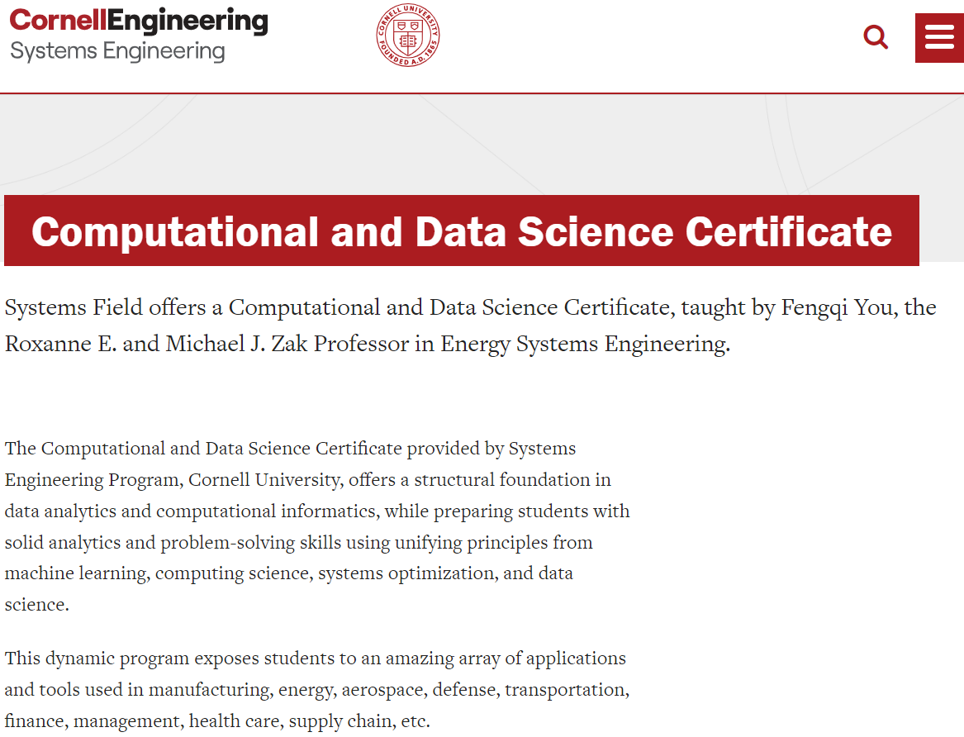
Computational and Data Science Curriculum
SysEn 5800/6800: Computational Optimization
SysEn 5888/6888: Deep Learning
Other courses that I taught before
SysEn 5880/6880: Industrial Big Data
Analytics & Machine Learning
ORIE 3310/5310: Optimization II
SysEn 5860: Quantum Computing and Artificial Intelligence

Slide 21
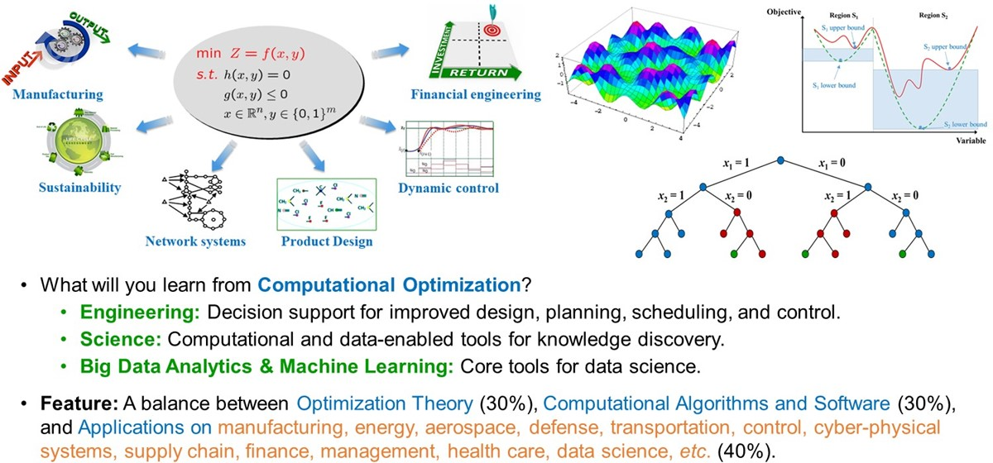
SysEn 5800/6800: Computational Optimization (now)
NO PRIOR PROGRAMMING EXPERIENCE NECESSARY!

Slide 22
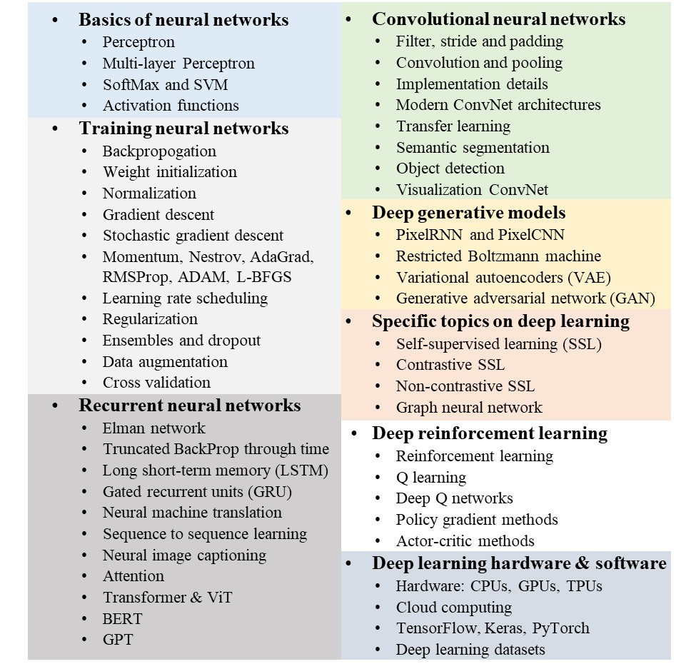
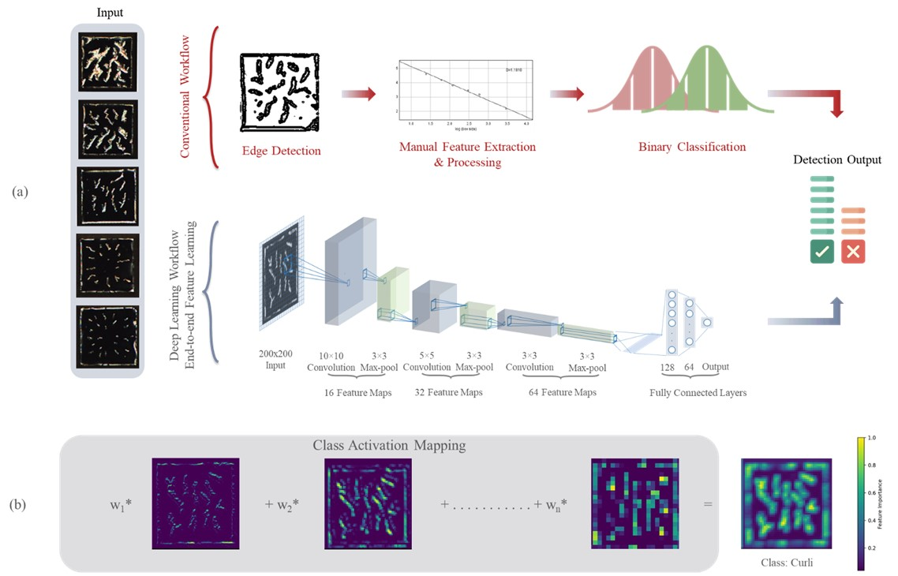
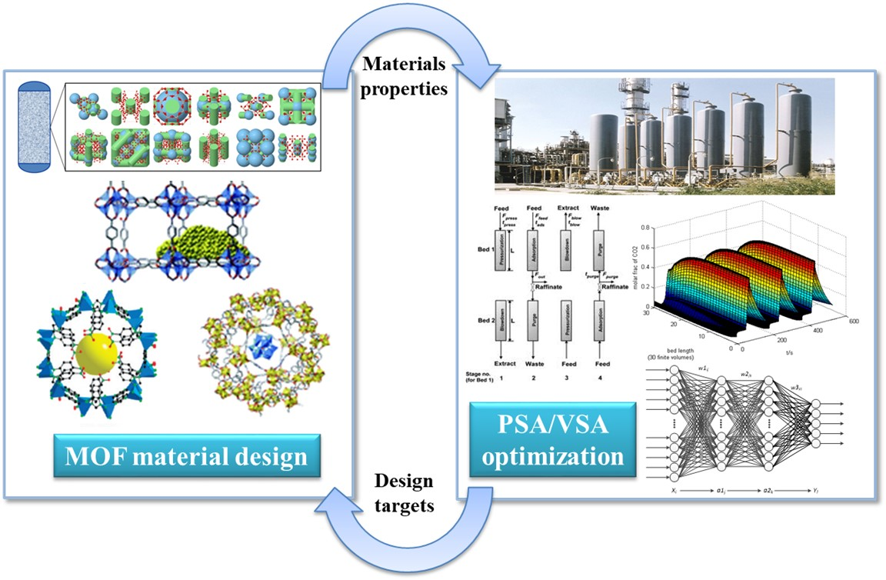
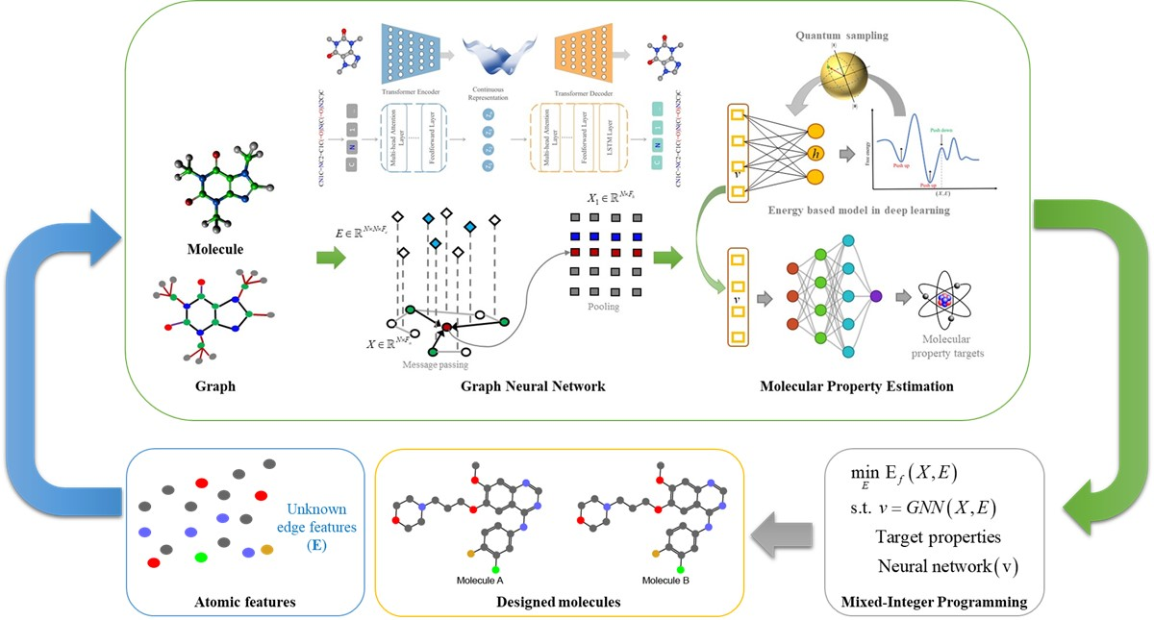
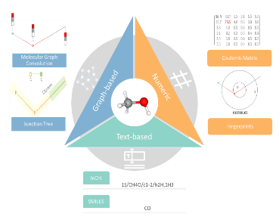

SysEn 5888/6888: Deep Learning (spring)
Soft sensors based on liquid crystal optical response
Rapid in-silico screening of metal organic frameworks (MOFs)
Materials/polymer design and optimization with QSPR
AlphaFold
Chemical language models for on-the-fly molecular generation

Slide 23
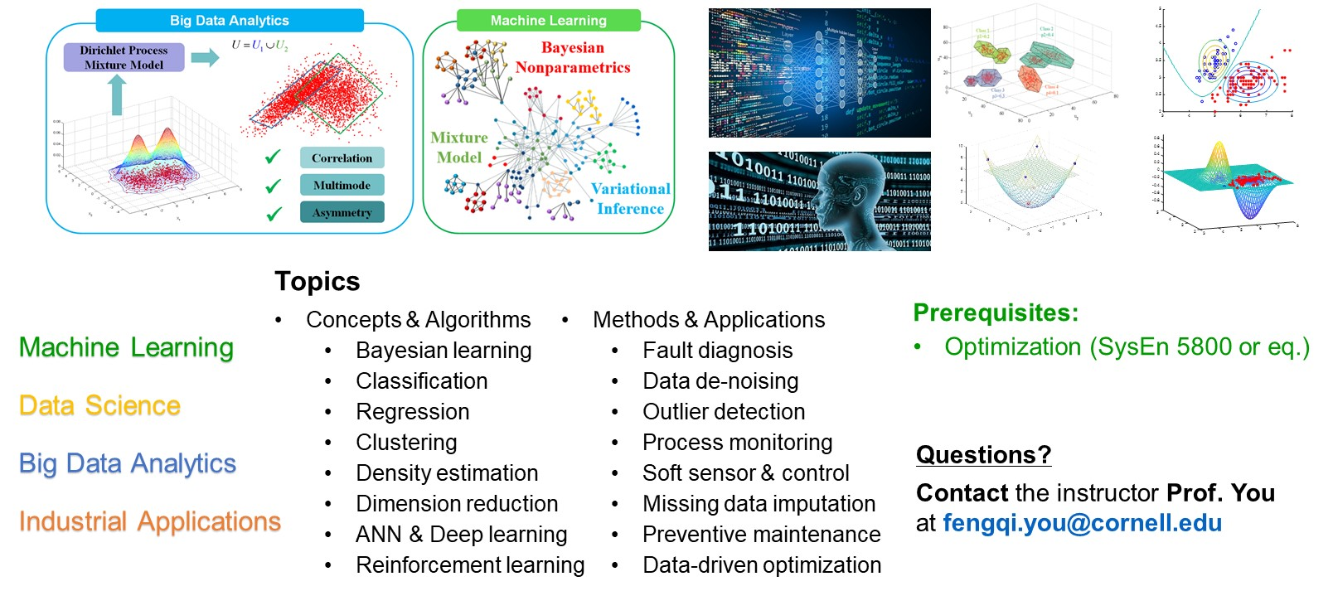
SysEn 5880/6880: Data Analytics & Machine Learning

