Slide 1

Mixed-Integer Linear Programming
Computational Optimization
Instructor: Fengqi You
Cornell University

Slide 2


Textbook
L.A. Wolsey, Integer programming. Wiley, 1998.
L.T. Biegler, I.E. Grossmann, A.W. Westerberg, Systematic Methods of Chemical Process Design. Prentice Hall Press, 1997.

Slide 3
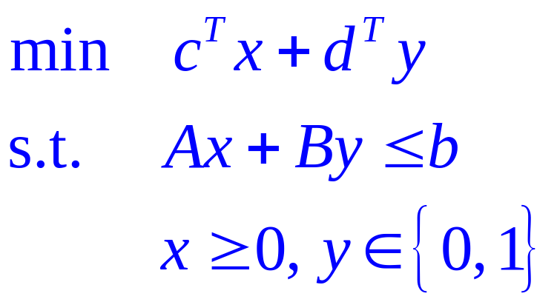

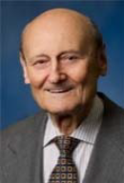
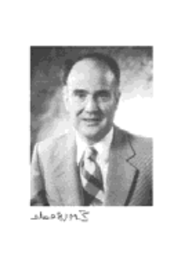

Mixed-Integer Linear Programming
x₂
x₁
Objective function and all constraints are linear
Some variables are continuous, and some are discrete/integer
Gomory (1958), Balas (1962), Dakin (1965), Nemhauser (1999)

Slide 4
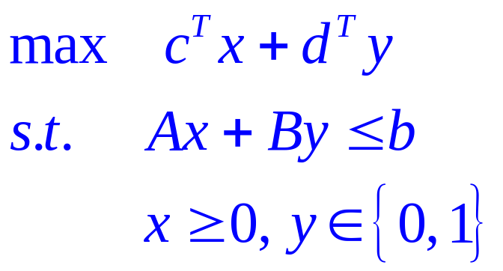
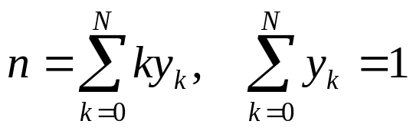
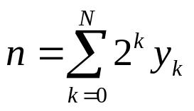
General Mixed-Integer Linear Program
There are no y variables ⇒ Linear Programming (LP)
There are no x variables ⇒ (pure) Integer Programming (IP)
We have both x and y ⇒ Mixed-Integer Linear Programming (MILP)
A general integer n ∈{0, 1, 2, 3, …N} can be modeled via binary variables y_{k}:
Fewer 0-1 variables
Weaker relaxation
or

Slide 5
Outline
Applications of MILP
  Synthesis of energy systems
  Reaction and conversion pathway/network analysis
  Scheduling of batch manufacturing processes
  Capacity planning of process networks
  Unit commitment for electric power systems operations
  Hospital operating room assignment and scheduling
Theory & Algorithm:
  Branch-and-bound algorithm
  Valid inequalities and cutting planes
  Disjunctive programming and logic optimization
Computational Issues

Slide 6
Project Selection
A company is thinking about building new facilities in LA and SF.
Total capital available for investment: $10M
Question: Which facilities should be built to maximize the total profit?
 | capital needed | expected profit
1. factory in LA | $6M | $9M
2. factory in SF | $3M | $5M
3. warehouse in LA | $5M | $6M
4. warehouse in SF | $2M | $4M

Slide 7
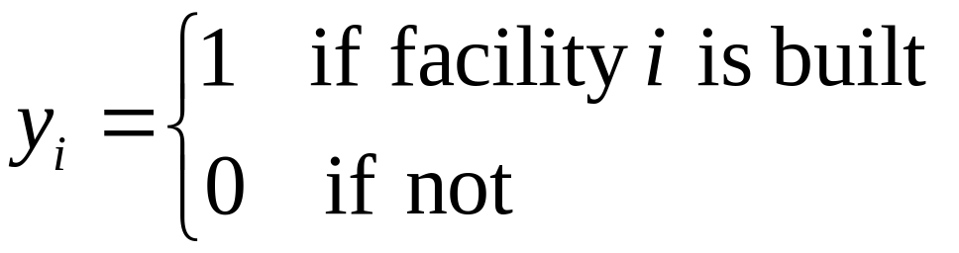
Project Selection
Define decision variables (i = 1, 2, 3, 4):
Then the total expected benefit: 9y₁+5y₂+6y₃+4y₄
the total capital needed: 6y₁+3y₂+5y₃+2y₄
Summarizing, the IP model is:
max 9y₁+5y₂+6y₃+4y₄
s.t. 6y₁+3y₂+5y₃+2y₄ ≤ 10
y_{i} ∈{0,1}

Slide 8
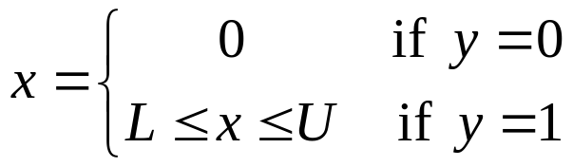

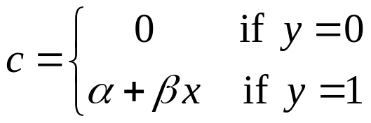
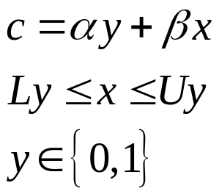






Modeling Discontinuous Domains and Functions
Discontinuous Domain
Discontinuous Function
$$y=0$$
$$y=1$$
$$⟺$$
0 L U
c
$$⟺$$
$$y=1$$
$$y=0$$
0 L U x

Slide 9
Process Planning
Data
  To produce 1 lb of product B, 1.4 lb of material A is required
  A: cost $0.15/lb, maximum availability = 80,000,000 lb/year
  B: price $0.35/lb, maximum demand = 50,000,000 lb/year
  Process operating cost: $0.06/lb of B produced
  Process investment cost
    Fixed charge: $4,000,000/year
    Variable cost: $0.01/lb/year of B
Question: should the plant be built? If so, at what capacity?
Material A
Process
Product B
1.4 lb
1 lb

Slide 10
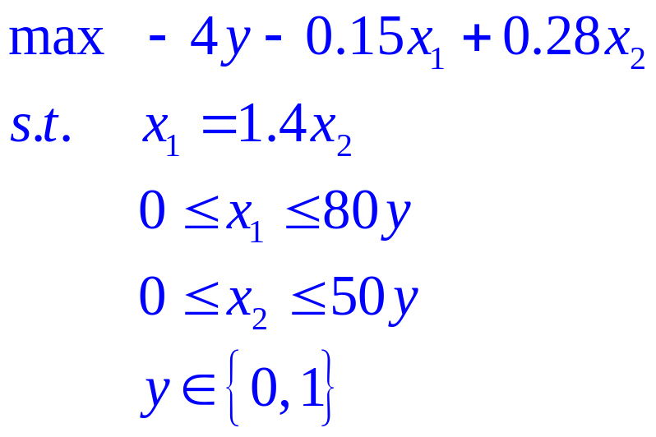
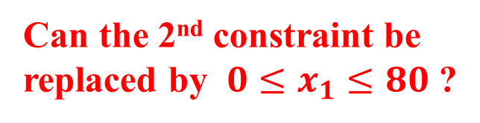
Model
Variables:
  x₁: amount of A consumed per year (million lb)
  x₂: amount of B produced per year (million lb)
  y: 0-1 variable; equals to 1 if the process installed; 0, otherwise
Annual profit = 0.35x₂ – 0.15x₁ – (4y + 0.01x₂) – 0.06x₂
  sales raw material investment operations
Model:
Can the 2nd constraint be replaced by $0≤x_{1}≤80$ ?

Slide 11
Exercise
Mass balance:
    To produce 1 lb of product B, 1.4 lb of material A is required
    To produce 1 lb of product C, 1.2 lb of material A is required
    A: cost $0.15/lb, maximum availability = 80,000,000 lb/year
    B: price $0.35/lb, maximum demand = 50,000,000 lb/year
    C: price $0.30/lb, maximum demand = 80,000,000 lb/year
Cost data: Process I Process II
    Operating cost $0.06/lb of B $0.05/lb of C
    Investment fixed cost $4,000,000/year $5,000,000/year
    Investment variable cost $0.01/lb/year of B $0.02/lb/year of C
Which plant(s) should be installed? At what capacity?
1.4 lb of A
1 lb of B
A
Process I
1.2 lb of A
1 lb of C
Process II

Slide 12
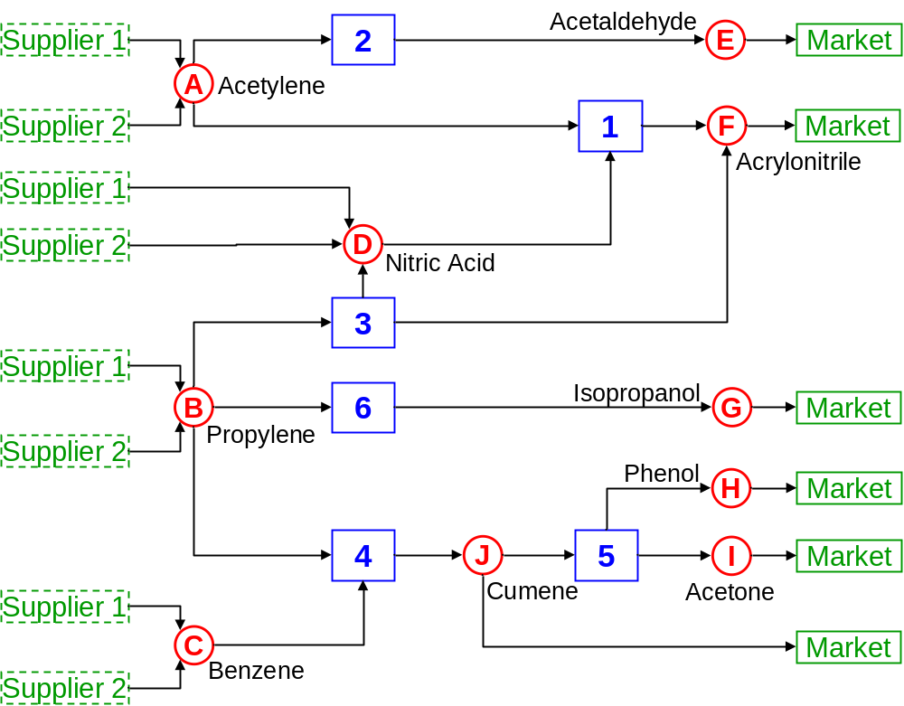
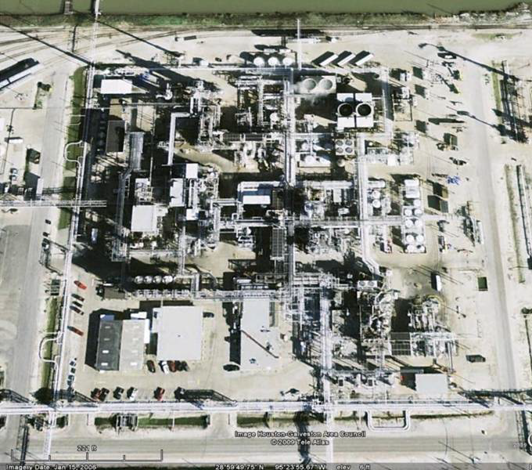
Process Network

Slide 13
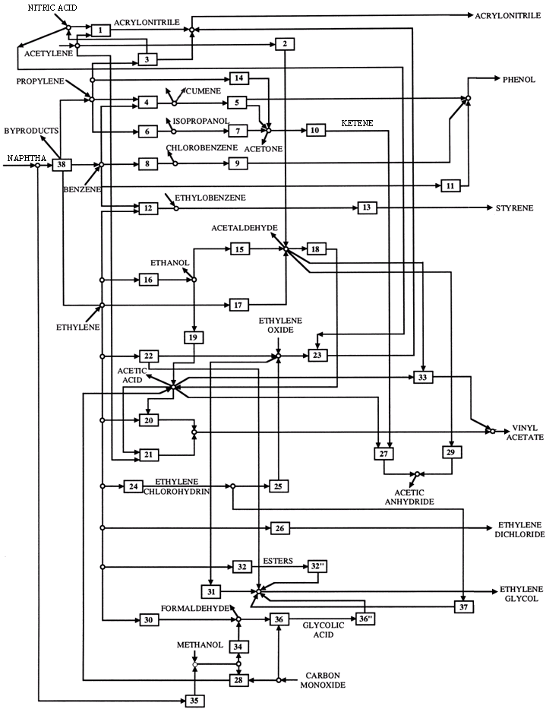
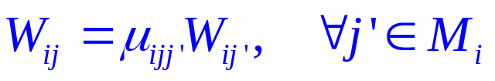
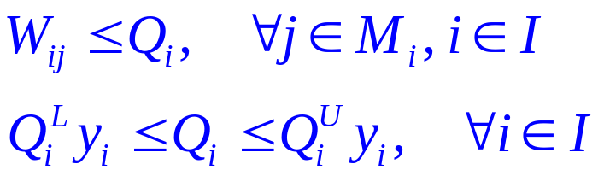
Extension to Process Network
Mass balance
  i for process, j, j’ for chemicals
  M_{i} is a set for main product
  W is a variable for production amt
  μ is a parameter for mass balance
Capacity & Installation
  Q is a variable for capacity
    Q^{U} and Q^{L} are parameters for upper and lower bounds
  y is a 0-1 variable for installation

Slide 14
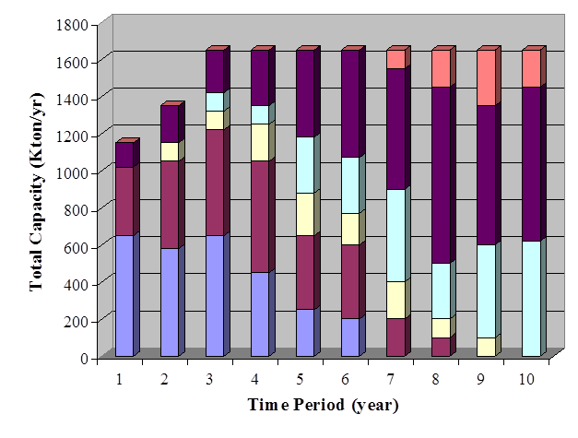
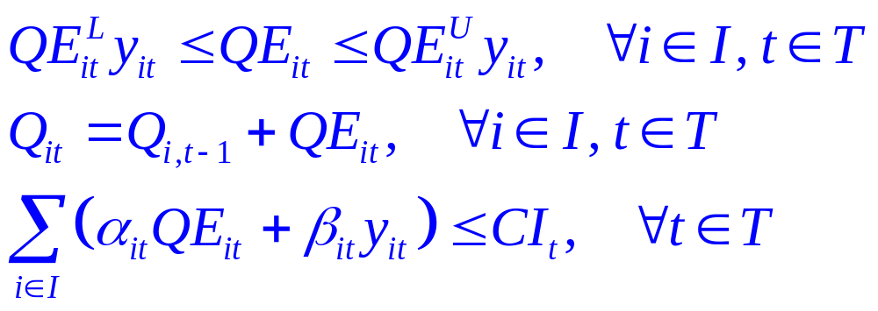
Extension to Multi-Period Capacity Planning
Consider a number of time periods
  Capacity of a process can be expanded in each time period
  Consider the balance of capacity level, subject to budget constraint
  QE is a variable for the capacity expansion level at each time period
  Q is a variable for the capacity at each time period
  α and β are parameters for variable / fixed costs of capacity expansion
  CI is a parameter for the budget limit of each time period

Slide 15
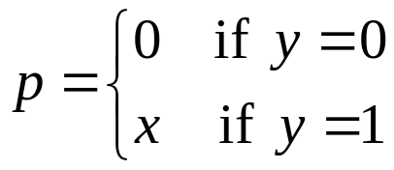
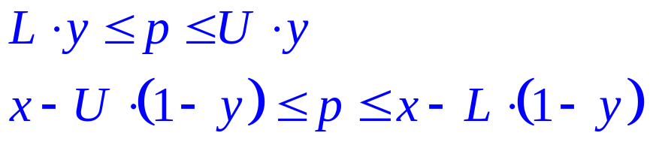
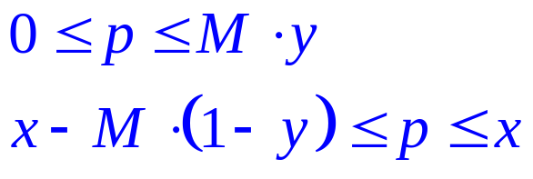
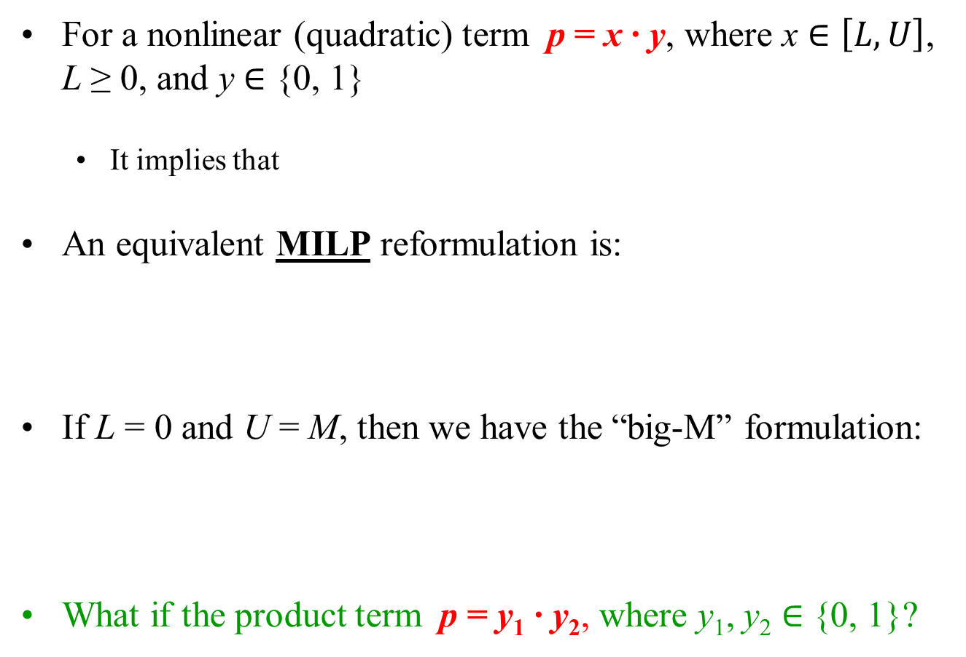
Mixed 0-1 Quadratic term (Glover’s Linearization)
For a nonlinear (quadratic) term p = x ∙ y, where x $∈\left[L, U\right]$, L ≥ 0, and y $∈$ {0, 1}
  It implies that
An equivalent MILP reformulation is:
If L = 0 and U = M, then we have the “big-M” formulation:
What if the product term p = y₁ ∙ y₂, where y₁, y₂ $∈$ {0, 1}?

Slide 16
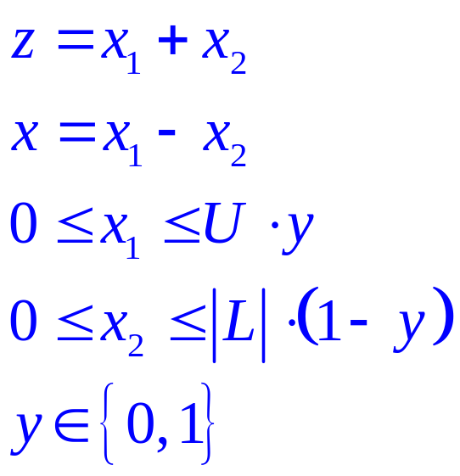
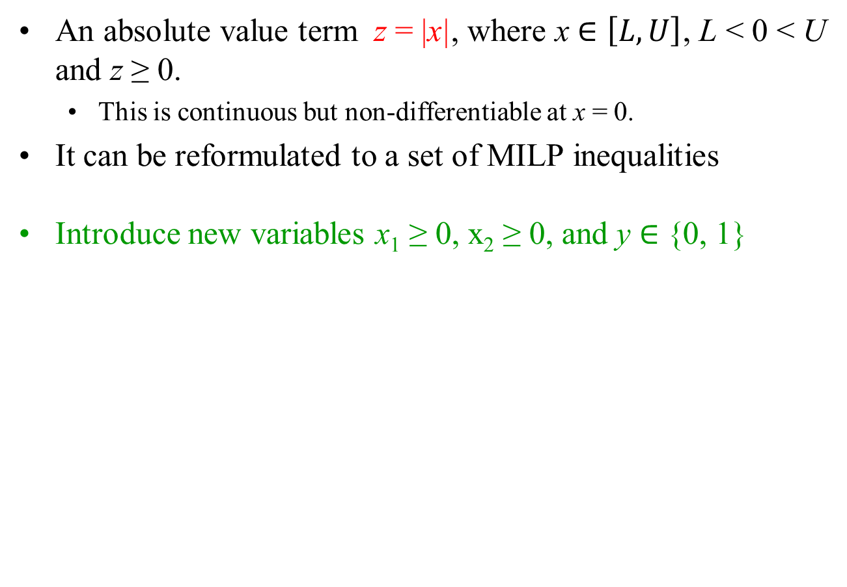
Modeling Absolute Value Terms
An absolute value term z = |x|, where x $∈\left[L, U\right]$, L < 0 < U and z ≥ 0.
  This is continuous but non-differentiable at x = 0.
It can be reformulated to a set of MILP inequalities
Introduce new variables x₁ ≥ 0, x₂ ≥ 0, and y $∈$ {0, 1}

Slide 17
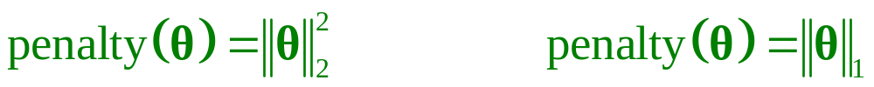
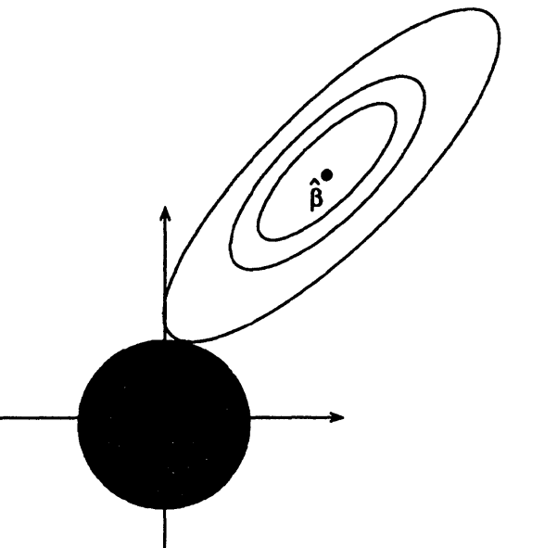
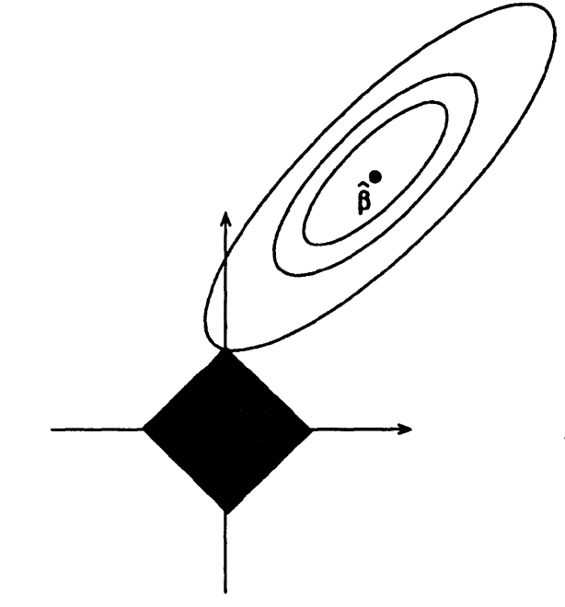
Why absolute value? Example: Ridge & LASSO
Ridge Regression: LASSO:
Ideally l0 penalty, but optimization becomes non-convex
θ with constant J(θ)
(level sets of J(θ))
θ with
constant
l2 norm
θ2
θ with
constant
l1 norm
θ with
constant
l0 norm
θ1
LASSO (l1 penalty) results in sparse solutions – vector with more zero coordinates
Good for high-dimensional problems – don’t have to store all coordinates!

Slide 18
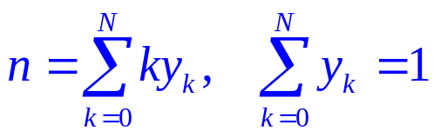
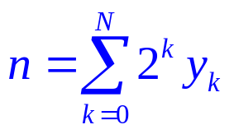
Modeling with Integer Variables
Multiple Choices
  At least one Exactly one At most one
Implication
  If select i then select k Select i if and only if select k
Integer Number
Also
Fewer 0-1 variables
Weaker relaxation

Slide 19
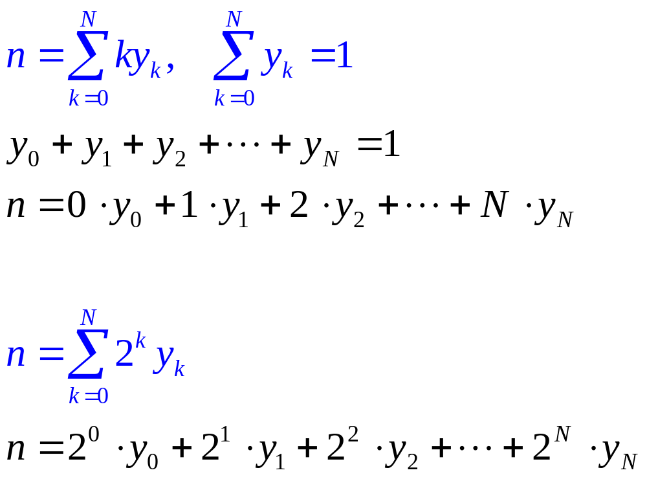
Modeling General Integer Variables with Binaries
One and only one y is selected
n = 0, 1, 2, …, N
Fewer 0-1 variables
Weaker relaxation
n = 0, 1, 2, …, 2^{N+1}-1

Slide 20
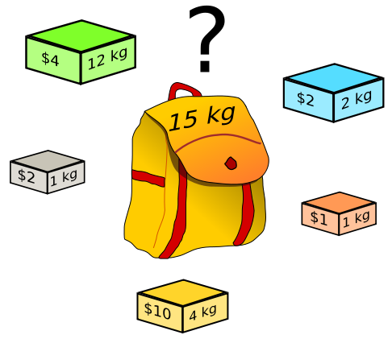
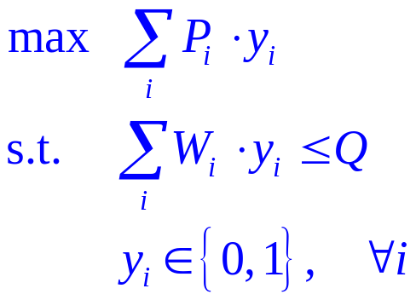
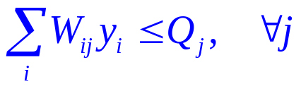
Knapsack Problem
We are given n items to be packed in a knapsack
Each item i ∈{1, 2, …n} has a value P_{i} and a weight W_{i}
The capacity of the knapsack is Q
The goal is to choose the items that fit in the knapsack with the max value.
Define:
  y_{i} = 1 if item i is chosen
  If we had multiple resources j ∈{1, 2, ..m}
  (e.g. weight, volume, etc.) with capacities Qj,
  we would replace the capacity constraint with:
Capacity Constraint

Slide 21
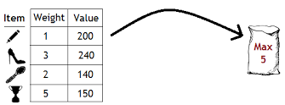
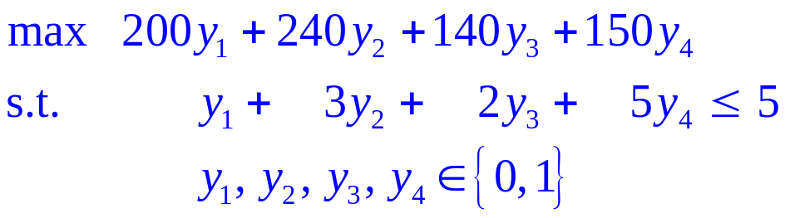
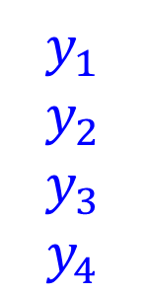
Example of Knapsack Problem
Given below item weight and market value of the items. How to maximize the market value earned of items by placing some or all of them into the knapsack with a capacity?
$$y_{1}$$
$$y_{2}$$
$$y_{3}$$
$$y_{4}$$

Slide 22
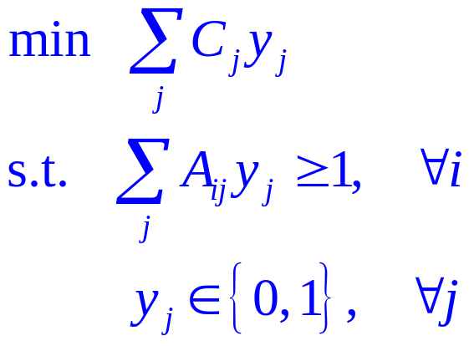
Set Covering Problem
We are given n tasks to be covered by m<n machines.
Each machine j ∈{1, …m} can carry out a subset of tasks I_{j}⊂I = {1, 2, …, n}
The compatibility is represented via parameter:
A_{ij} = 1 if i ∈ I_{j}
The cost of a machine is C_{j}
The objective is to find the set of machines that covers all tasks with the minimum cost
Define:
  y_{j} = 1 if machine j is chosen
NP-hard problem
Task i Machine j
1
2
3
4
n
1
2
3
4
m
…
…

Slide 23
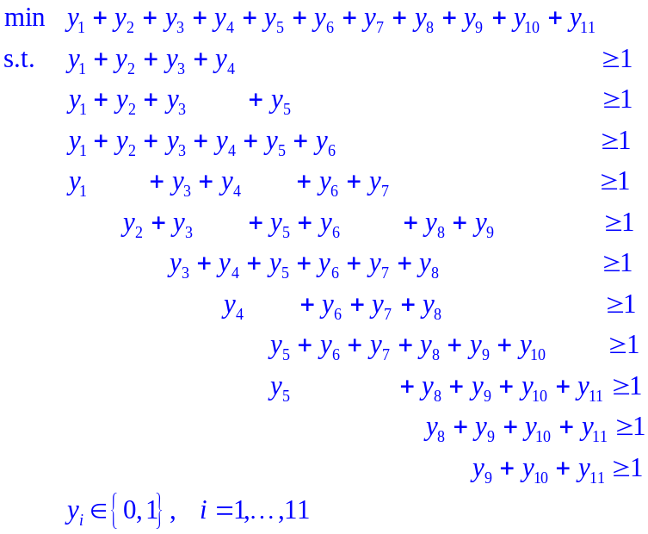
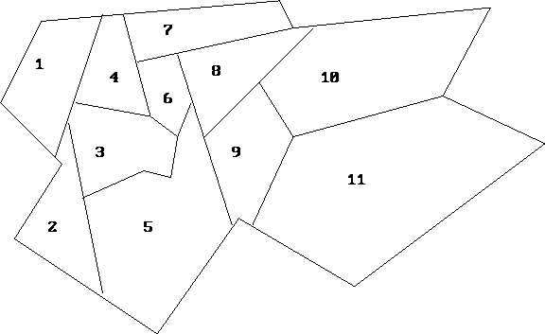
Set Covering Example: Location of Fire Station
Fire station(s) can be placed in any of the 11 neighborhoods
  A fire station can handle the fires for both its neighborhood and any adjacent neighborhood (any neighborhood with a non-zero border with its home neighborhood).
Minimize the total number of fire stations
  Another example: Cell tower coverage
    http://examples.gurobi.com/cell-tower-coverage/

Slide 24
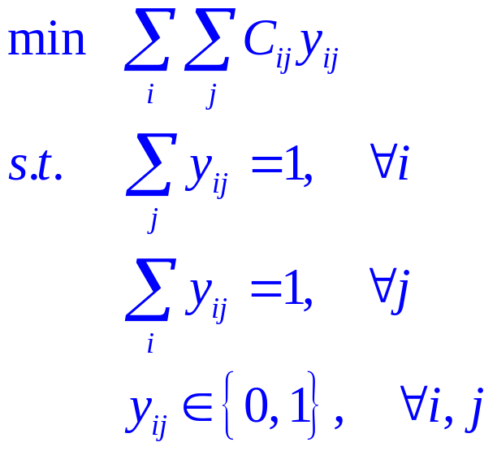
Assignment Problem
Task i Machine j
We are given n tasks and n machines
Each task i ∈{1, 2, …, n} has to be assigned to a machine j ∈{1, 2, …, n}
The cost of assignment is C_{ij}
The objective is to find the assignment with the minimum total cost
Define:
  y_{ij} = 1 if task i is assigned to machine j
  If solved as LP, there is always an optimal solution with integral values
1
2
3
4
n
1
2
3
4
n
…
…

Slide 25
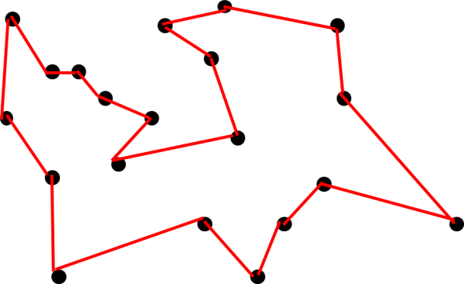
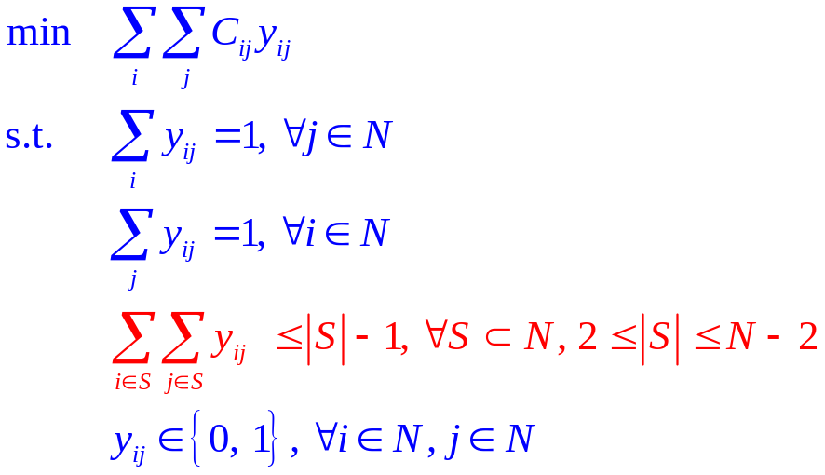
Traveling Salesman Problem
There are n cities to be visited exactly once by a traveling salesman
The distance/cost from city i to city j is C_{ij}
The objective is to find the sequence of cities that yield the minimum total distance/cost
Define:
  y_{ij} = 1 if we visit city i before city j
Constraint:
  Enter/exist each city once and only once
Subtour elimination constraint
An NP-complete problem
http://examples.gurobi.com/traveling-salesman-problem/

Slide 26
Example of TSP Subtours
1
5
3
4
2
6
1
5
3
4
2
6

Slide 27
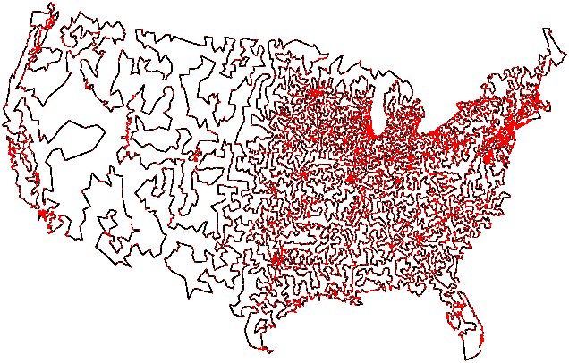
Traveling Salesman Problem Applications
Transportation: school bus routes, service calls, delivering meals / mailing (USPS, FedEx, UPS …)
Manufacturing: an industrial robot that drills holes in printed circuit boards, making multiple grades of polymers in a reactor …
Others: planning new telecommunication networks, genome sequencing (arranging DNA fragments in sequence)
This tour of 13,500 US cities
was generated by an advanced
algorithm that used several
“tricks” to limit the number of
possible tours (using 5 CPU-years)
http://www.tsp.gatech.edu

Slide 28
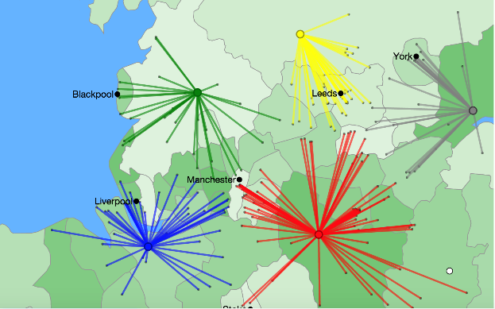
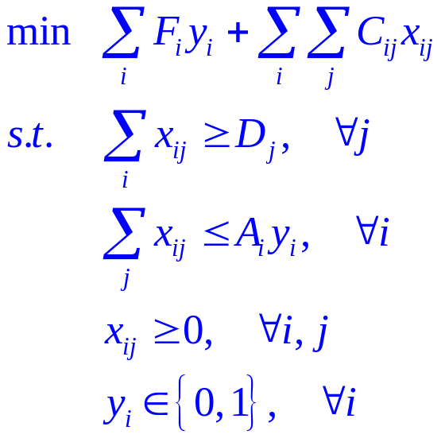
Facility Location Problem
There are n facilities (plants) and m customers
  We want to decide how to satisfy customer demand
  Which new facilities to build
  How much to produce and ship
Parameters
  The capacity of facility i ∈{1, 2, …, n} is A_{i}
  The cost of setting up facility i ∈{1, 2, …, n} is F_{i}
  The cost of shipping products from i to j is C_{ij}
  The demand of customer j ∈ {1, 2, …, m} is D_{j}
Variables
  x_{ij} = amount shipped from i to j
  y_{i} = 1 if we set up (install) facility i
http://examples.gurobi.com/facility-location

Slide 29
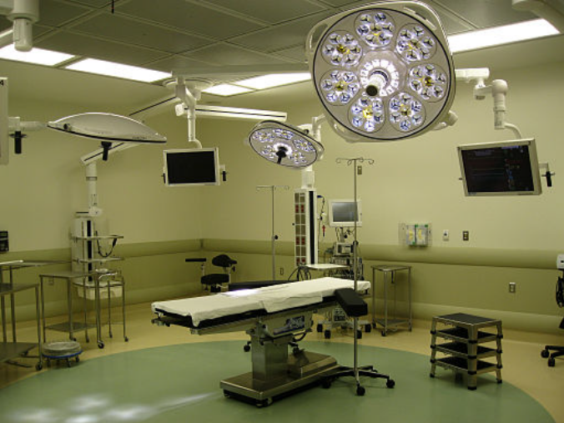
Operating Room Assignment/Scheduling
Limited number of operating rooms
Hospital needs to schedule the
assignment of operating rooms
to different departments weekly.
Challenges:
  Operating rooms are staffed in 8 hour blocks.
    If there are 10 operating rooms staffed Monday – Friday, then total would be 400 hours/week to assign
  Each operating room is assigned to at most one department per day
  Each department sets their own target number of allocation hours, which may not be integer.
  Departments may have daily and weekly requirements, e.g.
    Ophthalmology needs at least 2 operating rooms per week
    The oral surgeon is only present on Tuesdays and Thursdays.

Slide 30
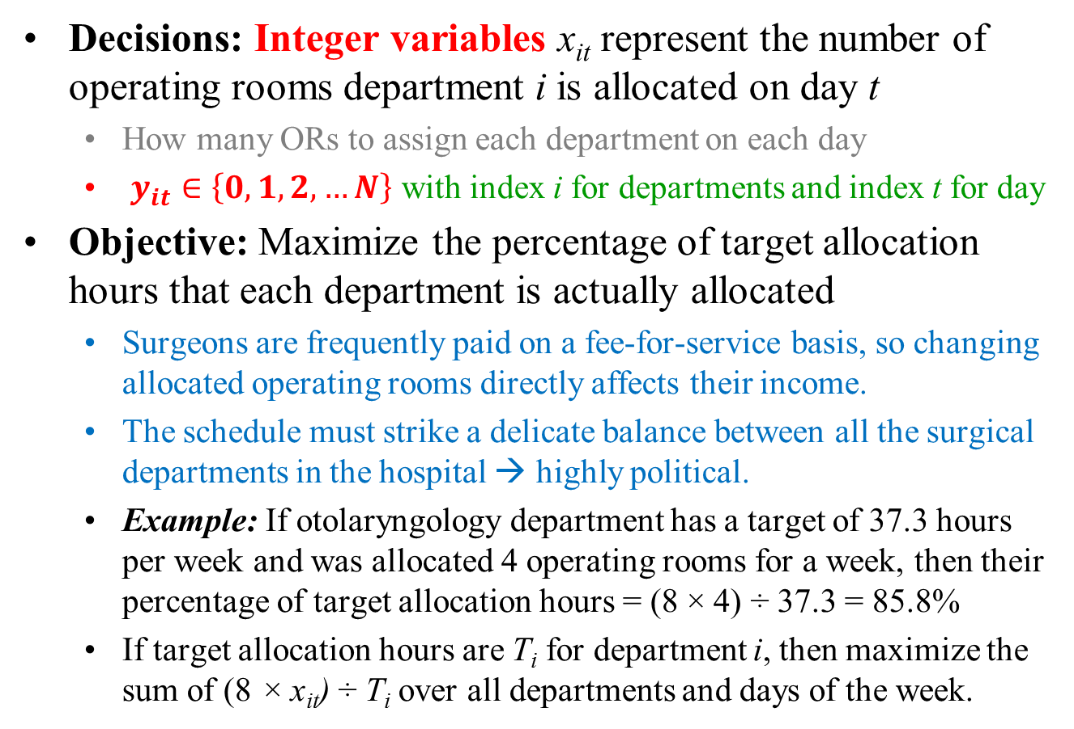
Operating Room Assignment/Scheduling
Decisions: Integer variables x_{it} represent the number of operating rooms department i is allocated on day t
  How many ORs to assign each department on each day
  $y_{it}∈\left\{0,1,2,…N\right\}$ with index i for departments and index t for day
Objective: Maximize the percentage of target allocation hours that each department is actually allocated
  Surgeons are frequently paid on a fee-for-service basis, so changing allocated operating rooms directly affects their income.
  The schedule must strike a delicate balance between all the surgical departments in the hospital → highly political.
  Example: If otolaryngology department has a target of 37.3 hours per week and was allocated 4 operating rooms for a week, then their percentage of target allocation hours = (8 × 4) ÷ 37.3 = 85.8%
  If target allocation hours are T_{i} for department i, then maximize the sum of (8 × x_{it}) ÷ T_{i} over all departments and days of the week.

Slide 31
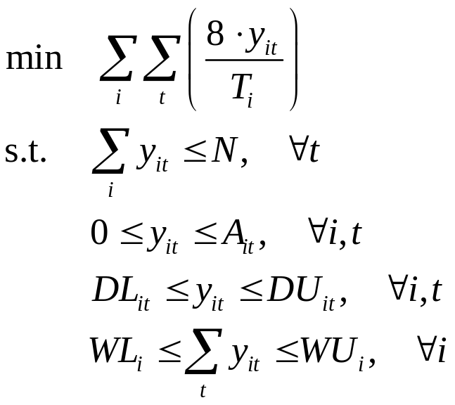
Operating Room Assignment/Scheduling
Parameters
T_{i} target allocation hours of department i
N maximum available operating rooms
A_{it} number of available surgery teams of
department i on day t
DL_{it} minimum number of operating rooms
required by department i on day t
DU_{it} maximum daily requirement
WL_{i} maximum number of operating rooms
required by department i of the week
WU_{i} maximum weekly requirement
Constraints
  At most N operating rooms are assigned every day
  The number of operating rooms allocated to a department on a given day cannot exceed the number of surgery teams that department has available that day
  Meet department daily/weekly minimums and maximums

Slide 32
Case study: Mount Sinai Hospital
Assigning 10 operating rooms (400 hours/week) to 5 dept.
Weekly Requirements by Dept.
Available Surgery Teams
Department | Minimum | Maximum
Ophthalmology | 3 | 6
Gynecology | 12 | 18
Oral Surgery | 2 | 3
Otolaryngology | 2 | 4
General Surgery | 18 | 25
Department | M | T | W | R | F
Ophthalmology | 2 | 2 | 2 | 2 | 2
Gynecology | 3 | 3 | 3 | 3 | 3
Oral Surgery | 0 | 1 | 0 | 1 | 0
Otolaryngology | 1 | 1 | 1 | 1 | 1
General Surgery | 6 | 6 | 6 | 6 | 6
Department | Weekly Target Allocation Hours
Ophthalmology | 39.8
Gynecology | 118.2
Oral Surgery | 19.9
Otolaryngology | 37.3
General Surgery | 189.7

Slide 33
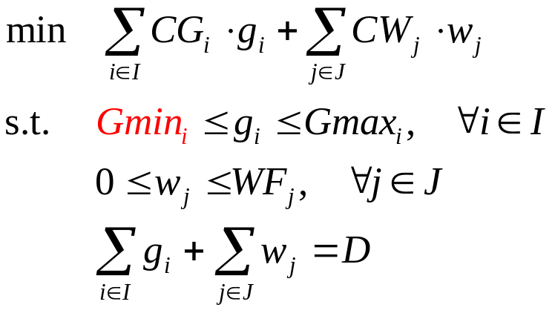

Revisited: Economic Dispatch
All generators must be dispatched over the minimum power output limit – might lead to absurd decisions or extra cost
Sets
I set of generators indexed by i
J set of generators indexed by j
Variables
g_{i} power output of generator i
w_{j} power injection from wind farm j
Parameters
CG_{i} unit production cost of generator i
CW_{j} unit power cost of wind farm j
D demand
Gmin_{i} minimum output of generator i
Gmax_{i} maximum output of generator I
WF_{j} power forecast of wind farm j

Slide 34

Unit Commitment (single period)
Introducing binary 0-1 variable u_{i} to model the on/off decisions for each thermal generation unit i
  Allowing the power output of a generator to be zero ( at “off” status)
Load
Unit 3
Unit 2
Unit 1
Time
0
6
12
18
24

Slide 35

Multi-Period Unit Commitment with Renewables
Extend to a multi-period planning/scheduling model
  Add set T indexed by t for time periods
  Model dynamic/time-dependent unit commitment decisions
  Account for start-up and shutdown decisions/costs
Binary 0-1 Variables
s_{it} equal to 1 if generator i is turned
on at time t ; otherwise, s_{it} =0.
f_{it} equal to 1 if generator i is shut
down at time t ; otherwise, f_{it} =0.
Parameters
SU_{i} start-up cost of generator i
SD_{i} shut down cost of generator i

Slide 36
Additional Considerations on Unit Commitment
Minimum up/down-time constraints
  Once a unit is started/shut-down, it should be on/off for at least a minimum up/down time before it can be shut-down/re-started.
Security on ramp up and ramp down of units
  To avoid damaging the turbine, the electrical output of a unit cannot change (i.e. increase/decrease) by more than a certain amount over some time
Reserve
  Rapid increase in production in case of unacceptable frequency drop due to unanticipated loss of a generating unit
  Protect the system against “credible outages”
  Types: (a) Increase output when generation < load, (b) Pumped hydro plants, (c) Demand reduction (e.g. voluntary load shedding)
Emission constraint/penalty

Slide 37

Security-Constrained Unit Commitment (SCUC)
Continuous Variables
r_{it} reserve of generator i at time t
Parameters
Cu_{i} no-load cost of generator i
MU_{i} minimum up time of generator i
MD_{i} minimum down time of generator i
RD_{it} ramp down rate of generator i at time t
RU_{it} ramp up rate of generator i at time t
Rmin_{t} system reserve requirement of time t
Rmax_{it} reserve capacity of generator i, time t

Slide 38
MILP Applications in Systems Engineering
Systems Design:
  Selection of equipment units (e.g. distillation vs. extraction) ‐ Superstructure optimization
  Selection of equipment sizes
  Matching in heat exchanger networks (hot ↔ cold pairs)
Systems Operations:
  Decision to expand/retrofit a process
  Scheduling of batch and continuous processes
Systems Control:
  Selection of linearized model for MPC
  On/off control action
Systems Biology
  Gene addition and/or knock‐out

Slide 39

Discrete Decisions in Process Design
Example: What is the best way to produce Vinyl Chloride Monomer?
(Turkay & Grossmann, 1998)
Optimization Decisions:
  Distillation sequence (discrete), Sizing (discrete or continuous),
  Operating conditions (continuous)

Slide 40


Synthesis of Distillation Sequences
Example: Separate mixture of A (lightest), B, C, D (heaviest) into pure components using sharp separation
Superstructure
F_{i} flows
y_{i} existence columns

Slide 41

Assumption: Perfect Recoveries

Slide 42




Example: Split Fraction
Can work with total flows
Notes:
In general terms, the problem can be stated as follow: we are given a PSCN,
as shown in the screen, it includes the suppliers, customers, plant sites and the transportation links between them. The investment cost and transportation costs are expressed by a fixed charge function.
As shown here. The transportation time and the supply and demand constraints are also given.

Slide 43

Input Parameters

Slide 44


MILP Model

Slide 45

Optimal Solution

Slide 46
General Problem Statement
Given:
  A multicomponent mixture tend to be separated into pure products
  Find a minimum cost separation sequence
Assumptions:
  Simple columns
  Fixed pressure
  Sharp splits and Perfect recoveries
  Adjacent key components for separation given inlet components
  Since 100% recovery assumed no need to “duplicate” columns (eg. A/B, B/C, C/D)
  Heat duties of condenser and reboiler as
  K_{c}, K_{R} are constants for fixed reflux ratios
Investment
Utility
Notes:
In general terms, the problem can be stated as follow: we are given a PSCN,
as shown in the screen, it includes the suppliers, customers, plant sites and the transportation links between them. The investment cost and transportation costs are expressed by a fixed charge function.
As shown here. The transportation time and the supply and demand constraints are also given.

Slide 47




General Model
For Col k, let
Define
    Set of intermediate products IP = {m}, e.g., IP = {(ABC), (AB)}
    COL = {k}
    FSF = {col k have as feed initial mixture} e.g. 1,2,3
    FSm = {col k have as feed intermediate m} e.g. 4->10
    PSm = {col k produce intermediate m} 1->7 (BCD Col 1)

Slide 48

MILP Model for Distillation Sequence
Model
Note: Generally K_{R}^{K} = K_{C}^{K}
Notes:
In general terms, the problem can be stated as follow: we are given a PSCN,
as shown in the screen, it includes the suppliers, customers, plant sites and the transportation links between them. The investment cost and transportation costs are expressed by a fixed charge function.
As shown here. The transportation time and the supply and demand constraints are also given.

Slide 49

Olefin Separation System (BP)
Goal: Synthesize optimal separation system

Slide 50

Process Superstructure

Slide 51

Optimal Solution (Successful Story)

Slide 52

Conversion Network Analysis and Optimization
Diverse pathways in a conversation/reaction networks from raw materials to final products
Example: Bioconversion network
8 biomass feedstocks
Hundreds of “known” conversion technologies
4 types of biofuels + 19 bioproducts

Slide 53

“Optimal Pathways” from Bioconversion Network
Help to identify:
Optimal production pathways for a given demand of product
Optimal utilization pathways for a given supply of feedstock
Optimal pathways for a given feedstock and product
Example network size
200 conversion technologies
142 feeds/intermediates/products

Slide 54
Optimal Pathway/Technology Selection Model
Minimize total annualized cost (CAPEX + OPEX)
  Subject to mass balance, production capacity, availability and demand
Sets
I set of feedstocks/intermediate/products indexed by i
J set of technologies/processes indexed by j
Binary 0-1 Variables
y_{j} selection of technology/process j
Continuous Variables
p_{i} purchase amount of product i
s_{i} sale amount of material/product i
q_{j} capacity of process with technology j
w_{j} production level of process with technology j

Slide 55
Optimal Pathway/Technology Selection Model
Sets
I set of feedstocks/intermediate/products indexed by i
J set of technologies/processes indexed by j
Parameters
f(∙) nonlinear function for capital cost
A_{i} maximum availability/supply of material/product i
D_{i} demand of product i
CP_{i} unit procurement cost of product i
CW_{i} unit production cost of product i
QL_{j} minimum process capacity level of process with technology j
QU_{j} maximum process capacity level of process with technology j
M_{i, j} conversion coefficient of product i in process with technology j

Slide 56

Optimal Pathway/Technology Selection Model
Capacity limitations
Production is limited to capacity
Mass balance
Availability constraint
Demand constraints
Use piecewise linear approximation to model nonlinear function f (q_{j}), and formulate the problem as an MILP

Slide 57


Piecewise Linear Function (Nonlinear)
Suppose the piecewise linear function f (x) has break points B₀, B₁, …, B_{p}

Slide 58

Example Solution

Slide 59


Batch Processing
Batch Process: more than ¼ of global production
  Specialty and performance chemicals
  Electronic/agricultural materials, metals
  Pharmaceutical ingredients, biochemicals
  … …
Features
  Sequence-dependent control policy
  Unsteady state operations
  Highly depend on manual operations
Production scheduling is the key issue
  What to be produced?
  How much to be produced?
  When/ in what order the batches are produced?
  Which equipment to be produced?

Slide 60
State Task Network (STN) (Kondili, Pantelides, Sargent, 1993)
M1
Reaction1
I2
Separation
P1
1h
M2
Heat
I1
M3
Reaction2
I3
Reaction 3
P2
I4
3 materials
(M1, M2, M3)
2 products
(P1, P2)
Heating
Reaction 1
Reactor 1
Reactor 2
Reactor 3
Column
Reaction 3
Reaction 2
Separation
0 1 2 3 4 5 6 Time (h)

Slide 61

Discrete Time Formulations
Main Assumptions
  The scheduling horizon is divided into a finite number of time intervals with known duration
  Tasks can only start or finish at the boundaries of these time intervals
Advantages
  Resource constraints are only monitored at predefined/fixed time points
  Simple models and easy representation of various scheduling features
Disadvantages
  Model size and complexity depend on the number of time intervals
  Constant processing times are required (rounding may be suboptimal)
  Changeovers are difficult to handle
Discrete Time Representation

Slide 62




Basics of MILP: Relaxation
General MILP problem (MILP)
  For general integer , use
Replacing the integrality requirement y∈{0,1} with y∈[0,1] leads to a relaxation (R-MILP), which is an LP:

Slide 63




Basics of MILP: Relaxation
Relaxation leads to a better objective value
  Larger for max. problem and smaller for min. problem
  In general, a relaxation of a problem is obtained by removing constraints (i.e. expanding the feasible region)
(MILP)
(R-MILP)

Slide 64

Relaxation Principle
Let Problem 1: $𝒪=\min_{x}\left\{f\left(x\right):x∈P_{1},x∈P_{2}\right\}$
Problem 2: $ℛ=\min_{x}\left\{f\left(x\right):x∈P_{1}\right\}$
If $\underset{x}{x^{∗}=argmin}\left\{f\left(x\right):x∈P_{1}\right\}$ (i.e. $ℛ=f\left(x^{∗}\right)$) and $x^{∗}∈P_{2}$, then $\underset{x}{x^{∗}=argmin}\left\{f\left(x\right):x∈P_{1},x∈P_{2}\right\}$
Proof:
  $ℛ$is a relaxation of $𝒪$ (why?), so $ℛ=f\left(x^{∗}\right)≤𝒪$
  Because $x^{∗}$ is a feasible solution of Problem 2 and $x^{∗}∈P_{2}$, it is easy to show that it is also a feasible solution of Problem 1 (why?) and hence $f\left(x^{∗}\right)≥𝒪$ (why?)
  We can conclude that $f\left(x^{∗}\right)=𝒪$ (why?)
  Since $x^{∗}$ is shown to be a feasible solution of Problem 1 and $f\left(x^{∗}\right)=𝒪$, $x^{∗}$ is the optimal solution of both problems. (why?)

Slide 65


Constraint Generation – TSP as An Example
An alternative formulation of TSP
Given a network with n cities to be visited exactly once by a traveling salesman
This is a complete undirected graph G = (N, E)
N = {1, 2, …, n}, E is the set of edges for every possible pair of different nodes i and j, say $e∈E$.
The distance from city i to city j is C_{ij}, or C_{e}.
Define: x_{e} = 1 if edge e is used in the selected tour
Objective: Find a tour w/ minimum total distance.
Degree constraints: Each node i should be connected to exactly two selected edges.
  δ(i) is the set of edges connecting to node i
Cut constraints: Eliminating subtours
  δ(S) is the set of edges in the cut that have one endpoint in S, and one endpoint in N-S

Slide 66


Example of TSP Formulation
Degree constraint: each node connects to two selected edges
  e.g. Node 1 connects to {1, 5} and {1, 2} – note that all edges are undirected
Cut constraint: each node connects to two selected edges
  e.g. S = {1, 2, 3}, N-S = {4, 5, 6}, then the following graph violates the cut constraint (why rhs is 2 instead of 1)?
1
5
3
4
2
6
1
5
3
4
2
6

Slide 67

Solving TSP with LP-based Constraint Generation
Solving the LP relaxation of the TSP problem with only the degree constraints:
Check if the solution satisfies the cut constraints below. If no constraint is violated, the current solution is optimal. If a violated constraint is found, add it to the LP problem above, and re-solve this “updated” LP, i.e. constraint generation.

Slide 68

Solving TSP with LP-based Constraint Generation
Starting from a solution from the TSP-LP problem (with degree constraints only plus newly added “violated” constraints), let’s denote it as x*.
How to check if x* satisfies the cut constraint?
Formulate it as a minimum-cut problem!
  Take the complete graph G = (N, E), and build a directed graph D as follows: for each undirected edge {i, j} include two directed edges (i, j) and (j, i) and give each of these two edges the capacity x*_{{i, j}.} Let node 1 be the source node. Then, for each node t = 2, 3, …, N, let t be the sink node, and fund the minimum cut separating node 1 and node t in D (e.g. using the Ford-Fulkerson algorithm); if the resulting minimum cut (S, N-S) (where $1∈S$ and $t∈N−S$) has capacity less than 2, then S gives a cut constraint that is violated by x*. If the minimum cut for every t = 2, 3, …, N has capacity at least 2, then all cut constraints are satisfied.

Slide 69
Example of TSP
An “optimal” solution from solving the LP relaxation of TSP with degree constraints only
  Solid blue lines are for x_{e} = 1; Dash yellow lines are for x_{e} = 0.5;
If choose S = {1, 2, 3}, then
the flow capacity is 1, which
is less than 2.
The Separation Procedure
could find this cut when
choose node 4 as the sink.
1
5
3
4
2
6

Slide 70
What is the Optimal solution of a 2-Variable IP?
maximize 3x + 4y
s.t. 5x + 8y ≤ 24, x, y ≥ 0 and integer
Question: What is the optimal integer solution?
What is the optimal linear solution?
Can one use linear programming to solve the integer program?
0 1 2 3 4 5
0 1 2 3 4 5

Slide 71
A Rounding Technique Might NOT Be Useful
maximize 3x + 4y
s.t. 5x + 8y ≤ 24, x, y ≥ 0 and integer
Solve LP (ignore integrality) get x=4.8, y=0 and z =14.4
Round, get x=5, y=0, infeasible!
Truncate, get x=4, y=0, and z =12
Same solution value at x=0, y=3
Optimal is x=3, y=1 and z =13
0 1 2 3 4 5
0 1 2 3 4 5

Slide 72

Another Example
LP relaxation, then round off ?
Round off?
x₁ = 5
x₂ = 3
max z = 3 x₁ + 4 x₂
s.t. 2x₁ + 6 x₂ ≤ 27
x₂ ≥ 2
3x₁ + x₂ ≤ 19
x₁ , x₂ ≥ 0 and Integer
Round up?
x₁ = 6
x₂ = 3
Round down?
x₁ = 5
x₂ = 2
IP Optimal
x₁ = 4
x₂ = 3
LP Optimal
x₁ = 5 ⁷/₁₆
x₂ = 2 ¹¹/₁₆

Slide 73
The Mystery of Integer Programming
Integer variables make an optimization problem much more difficult to solve. Memory and solution time may rise exponentially as more integer variables are added
  Some integer programs are easy (millions of variables)
  Some integer programs are hard (some problem with only 100 variables that have never been solved to optimality)
  many combinations of specific integer values for the variables must be tested, and each combination requires the solution of a "normal" LP. The number of combinations can rise exponentially with the size of the problem.
Solvers for integer programs are extremely sensitive to the formulation. (not true for LPs)
  There are often multiple ways of modeling the same integer program, where integer variables can be used to model yes/no decisions

Slide 74



Solution Techniques for Integer Programs
Enumeration
  Complete enumeration
    list all “solutions” and choose the best
    For n binary variables, there are 2^{n+1} nodes (subproblems).
  Branch and bound (Implicit enumeration by solving LPs)
    Implicitly search all solutions, but cleverly eliminate the vast majority before they are even searched based on bounds
    Solution process is for “closing the gap”
Cutting plane techniques
  Use LP to solve integer programs by adding
  constraints to eliminate the fractional solutions.
Branch-and-cut
  Branch and Bound with cutting planes

Slide 75

Complete Enumeration
Systematically considers all possible values of the decision variables.
  If there are n binary variables, there are 2^{n} different ways.
Iteratively break the problem in two. At the 1st iteration, we consider separately the case that x₁ = 0 and x₁ = 1.

Slide 76
Complete Enumeration – Time Consuming
Suppose that we could evaluate 1 billion solutions per second. Let n = number of binary variables
Solutions times
  n = 30, 1 second
  n = 40, 17 minutes
  n = 50 11.6 days
  n = 60 31 years
Suppose that we could evaluate 1 trillion solutions per sec.
Solutions times
  n = 70, 1 second
  n = 80, 17 minutes
  n = 90 11.6 days
  n = 100 31 years

Slide 77
Branch and Bound
Implicitly enumerate all possible integer solutions
  By solving a single subproblem, many possible solutions may be eliminated from consideration
Key idea:
  Search the enumeration tree, but at each node solve the linear program at the node and eliminate the subtree (fathom it) if
    The solution is integer (there is no need to go further) or
    The best solution in the subtree cannot be as good as the best available solution (for the current upper bound) or
    There is no feasible solution
If it is unnecessary to branch on a subproblem, we say that it is “fathomed”

Slide 78
Branch-and-Bound Overview
x₁ = 1
x₁ = 0
x₂ = 1
x₂ = 0
x₂ = 1
x₂ = 0
Recursively solve linear program at each node by fixing the values/bounds of the integer variables
Fathom if (1) lower bound at node is larger than value of a known feasible solution (i.e. upper bound), (2) integer solution is found, or (3) LP is infeasible

Slide 79
Example Problem
maximize 16x₁ + 22x₂ + 12x₃ + 8x₄ +11x₅ + 19x₆
subject to 5x₁ + 7x₂ + 4x₃ + 3x₄ +4x₅ + 6x₆ ≤ 14
x_{j} = 0, 1 for j = 1 to 6

Slide 80
Node 1 is the original LP Relaxation
1
44 3/7
maximize 16x₁ + 22x₂ + 12x₃ + 8x₄ +11x₅ + 19x₆
subject to 5x₁ + 7x₂ + 4x₃ + 3x₄ +4x₅ + 6x₆ ≤ 14
0 ≤ x_{j} ≤ 1 for j = 1 to 6
Solution at node 1:
x₁ =1 x₂ = 3/7 x₃ = x₄ = x₅ = 0 x₆ =1 z = 44 3/7
The IP cannot have value higher than 44 3/7.

Slide 81
Node 2 is the LP Relaxation plus constraint x₁ = 0
1
44 3/7
x₁ = 0
2
44
maximize 16x₁ + 22x₂ + 12x₃ + 8x₄ +11x₅ + 19x₆
subject to 5x₁ + 7x₂ + 4x₃ + 3x₄ +4x₅ + 6x₆ ≤ 14
0 ≤ x_{j} ≤ 1 for j = 1 to 6, x₁ = 0
Solution at node 2:
x₁ = 0 x₂ = 1 x₃ = 1/4 x₄ = x₅ = 0 x₆ = 1 z = 44

Slide 82
Node 3 is the LP Relaxation plus constraint x₁ = 1
1
44 3/7
x₁ = 0
x₁ = 1
2
3
44 3/7
44
The solution at node 1 was
x₁ =1 x₂ = 3/7 x₃ = x₄ = x₅ = 0 x₆ =1 z = 44 3/7
Note: it was the best solution with no constraint on x₁. So, it is also the solution for node 3. (If you add a constraint and the old optimal solution is feasible, then it is still optimal)

Slide 83
Node 4 is LP Relaxation plus constraints x₁ = 0 & x₂ = 0
1
1
44 3/7
x₁ = 0
x₁ = 1
2
3
44
44 3/7
x₂ = 0
4
4
42
Solution at node 4: X = [ 0 0 1 0 1 1 ], z = 42
Our first integer solution!
  No further searching from node 4 because there cannot be a better integer solution
  No solution in the subtree can have a value better than 42

Slide 84
Solve the LP’s at Nodes 5, 6, and 7
1
1
44 3/7
x₁ = 0
x₁ = 1
44
2
3
44 3/7
x₂ = 0
x₂ = 1
x₂ = 0
x₂ = 1
4
4
5
6
7
42
44
44
44 1/3
We would eliminate (fathom) a subtree if no solution in the subtree would be better than the upper bound (42).
  No new integer solutions were found.
  The integer solution is the best solution on hand.
  The current best bound is 42

Slide 85
Solve the LP’s at Nodes 8 - 13
1
44 3/7
x₁ = 0
x₁ = 1
2
3
44
44 3/7
x₂ = 0
x₂ = 1
x₂ = 0
x₂ = 1
4
42
4
5
6
7
44
44
44 1/3
x₃ = 0
x₃ = 1
x₃ = 0
x₃ = 1
x₃ = 0
x₃ = 1
43.75
8
43.5
9
43.25
10
43.8
11
44.3
12
-∞
13
We have solved 13 different linear programs so far.
  One integer solution found, and one subtree fathomed (pruned) because the solution is integer (node 4) with a value of 42
  One subtree fathomed because the solution is infeasible (node 13) – why fathom the substree if the node is infeasible?

Slide 86
Solve the LP’s associated with the Next Nodes
1
44 3/7
x₁ = 0
x₁ = 1
2
3
44
44 3/7
x₂ = 0
x₂ = 1
x₂ = 0
x₂ = 1
42
4
44
5
44
6
44 1/3
7
x₃ = 0
x₃ = 1
x₃ = 0
x₃ = 1
x₃ = 0
x₃ = 1
43.75
8
43.5
9
43.25
10
43.8
11
44.3
12
-∞
13
We can fathom the node with z = 42.66. Why?
  The bound at each node is obtained by solving an LP, but all variable are integer, and so the objective is integer
  If the best integer valued solution for a node is 42.66, then we know the best bound is at most 42, so do other bounds.
43.75
42.66

Slide 87
Round Down All the Bounds
1
44
x₁ = 0
x₁ = 1
2
3
44
44
x₂ = 0
x₂ = 1
x₂ = 0
x₂ = 1
42
4
44
5
44
6
44 1/3
7
x₃ = 0
x₃ = 1
x₃ = 0
x₃ = 1
x₃ = 0
x₃ = 1
43
8
43
9
43
10
43
11
44
12
-∞
13
43
42
The best solution has value 42

Slide 88
Solving More Nodes
1
44
x₁ = 0
x₁ = 1
2
3
44
44
x₂ = 0
x₂ = 1
x₂ = 0
x₂ = 1
42
4
44
5
44
6
44 1/3
7
x₃ = 0
x₃ = 1
x₃ = 0
x₃ = 1
x₃ = 0
x₃ = 1
43
8
43
9
43
10
43
11
44
12
-∞
13
43
42
43
42
43
43
We found a new integer solution!
x₁ = 1, x₂ = x₃ = 0, x₄ = 1, x₅ = 0, x₆ = 1 z = 43
The current best solution has value 43

Slide 89
Fathom
1
44
x₁ = 0
x₁ = 1
The best integer solution has value 43
2
3
44
44
x₂ = 0
x₂ = 1
x₂ = 0
x₂ = 1
42
4
5
6
7
44
44
44
x₃ = 0
x₃ = 1
x₃ = 0
x₃ = 1
x₃ = 0
x₃ = 1
8
9
10
11
43
43
43
43
44
8
9
10
11
12
-∞
13
If we had found this integer solution earlier, we could have saved some searching

Slide 90
Finishing Up
1
44
x₁ = 0
x₁ = 1
The best integer solution has value 43
2
3
44
44
x₂ = 0
x₂ = 1
x₂ = 0
x₂ = 1
42
4
5
6
7
44
44
44
x₃ = 0
x₃ = 1
x₃ = 0
x₃ = 1
x₃ = 0
x₃ = 1
8
9
10
11
43
43
43
43
44
8
9
10
11
12
-∞
13
44
14
15
-∞
44
16
17
-∞
38
18
19
-∞

Slide 91
Lessons Learned
Branch and Bound can speed up the search
  Only 25 nodes (linear programs) were evaluated
  Other nodes were fathomed
Obtaining a good feasible solution earlier can be valuable
  only 19 nodes would have been evaluated
Solve linear programs faster, because we start with an excellent or optimal solution
  uses a technique called the dual simplex method
Obtaining better bounds can be valuable
  We sometimes use properties that are obvious to us, such as the fact that integer solutions have integer solution values

Slide 92
Branch and Bound
Notation:
  z* = optimal integer solution value
  Subdivision: a node of the B&B Tree
  Incumbent: the best integer feasible solution on hand
  z^{I}: value of the incumbent, i.e. the lower bound
  z^{LP}: value of the LP relaxation of the current node, giving a upper bound
  Children of a node: the two problems created for a node, e.g., by saying x_{j} = 1 or x_{j} = 0
  LIST: the collection of active (not fathomed) nodes, with no active children
NOTE: z^{I} ≤ z*

Slide 93
Illustrating the definitions
1
44 3/7
x₁ = 0
x₁ = 1
The best integer solution has value 42
2
3
44
44 3/7
x₂ = 0
x₂ = 1
x₂ = 0
x₂ = 1
4
42
4
5
6
7
44
44
44 1/3
x₃ = 0
x₃ = 1
x₃ = 0
x₃ = 1
x₃ = 0
x₃ = 1
43.75
8
43.5
9
43.25
10
43.8
11
44.3
12
-∞
13
z* = 43 = optimal integer solution value. (We found it later in the search)
Currently best integer solution is 0 0 1 0 1 1 z^{I} = 42.
It is the optimal solution for the subdivision 4
The z^{LP} values for each subdivision are next to the nodes

Slide 94
Illustrating the definitions
1
44 3/7
x₁ = 0
x₁ = 1
The best integer solution has value 42
2
3
44
44 3/7
x₂ = 0
x₂ = 1
x₂ = 0
x₂ = 1
4
42
4
5
6
7
44
44
44 1/3
x₃ = 0
x₃ = 1
x₃ = 0
x₃ = 1
x₃ = 0
x₃ = 1
43.75
8
43.5
9
43.25
10
43.8
11
44.3
12
-∞
13
The children of node (subdivision) 1 are nodes 2 and 3.
The children of node 3 are nodes 6 and 7
LIST = { 8, 9, 10, 11, 12 } = unfathomed nodes with no active children

Slide 95
Branch and Bound Algorithm
INITIALIZE LIST = {original problem}
Best integer solution: = ∅
z^{I} = -∞
SELECT:
  If LIST = ∅, then the current integer solution is optimal if it exists, and the problem is infeasible if no integer solution exists;
  else, let S be a node (subdivision) from LIST.
  Let x^{LP} be the optimal solution to S
  Let z^{LP} = its objective value
FATHOM & BRANCH
  Four cases
44 3/7
1
e.g., S = {1}

Slide 96
Branch and Bound Algorithm
CASE 1. z^{LP} = -∞ (the LP is infeasible)
  Remove S from LIST (fathom), return to SELECT
  e.g., S = {13}
CASE 2. -∞ < z^{LP} ≤ z^{I}
  That is, the LP is dominated by the upper bound.
  Then remove S from LIST (fathom), return to SELECT
  e.g., the upper bound is 43, and node 14 is selected. z^{LP} = 43
-∞
13
13
43
8
8
43
42
14
14

Slide 97
Branch and Bound Algorithm
CASE 3. z^{I} < z^{LP} and x^{LP} is integral
  That is, the LP solution is integral and dominates the incumbent and the current upper bound.
  Then Incumbent := x^{LP}; z^{I} := z^{LP}
  Remove S from LIST (fathomed by integrality), return to SELECT
  e.g., node 4 was selected, and the solution to the LP was integer-valued.
CASE 4. z^{I} < z^{LP} and x^{LP} is not integral
  There is not enough information to fathom S
  Remove S from LIST, add the children of S
  to LIST, return to SELECT
  e.g., select node 3.
4
4
42
x₁ = 1
3
44 3/7
x₂ = 0
x₂ = 1
List := List – 3 + {6,7}
6
7

Slide 98



Node Selection Rules
Depth-first Search:
  Always choose one of the new subproblems just generated; typically the one with the best lower bound
  Backtrack when node is discarded
  Advantages: can potentially find a (good) solution fast
  Disadvantages: “Hidden” good solutions difficult to find
Best-first Search:
  Always choose the subproblem with the best lower bound
  Advantages: examines potentially good nodes; uniformly tighten bounds
  Disadvantages: tree tends to be larger
Breadth-first Search:
  Expand all nodes at a level before going to the next
  Not used in practice

Slide 99
Selection/ Branching Rules
Rule of Thumb 1: Don’t let LIST get too big (the solutions must be stored). So, prefer nodes that are further down in the tree – Depth-first Search
Rule of Thumb 2: Pick a node of LIST that is likely to lead to an improved the currently best solution. Sometimes heuristics are used to come up with a good feasible solution.
Rule of thumb 3: if it appears clear that x_{j} = 1 in an optimal solution, it is often good to branch on x_{j} = 0 vs x_{j} = 1 The hope is that a subdivision with x_{j} = 0 can be pruned
Rule of thumb 4: branching on important variables is worthwhile

Slide 100
Branch and Bound for General Integer Program
Solving an IP with general integer variables n ∈{0, 1, 2, 3, …N}
Approach 1: A general integer n ∈{0, 1, 2, 3, …N} can be modeled via binary variables y_{k}:
Approach 2: Generating subproblems by branching on an appropriately chosen fractional-valued variable
  Suppose a fractional value between the integers i and i+1. Then the two newly generated subproblems are
  New Subproblem 1 Old subproblem + Constraint x_{i} ≤ i
  New Subproblem 2 Old subproblem + Constraint x_{i} ≥ i + 1
Fewer 0-1 variables
Weaker relaxation
or

Slide 101

Branch and Bound Example
X₂
X₁

Slide 102






Branch and Bound Example
Bounding: solve linear programming relaxation:
Branching: divide into 2 subproblems:
X₂
upper = 59/7 ≈ 8.43
X₁

Slide 103


Branch and Bound Example
Node selection: select (highest) right node
Bounding: solve linear programming relaxation: infeasible
Node is thus fathomed by infeasibility
X₂
upper = 59/7 ≈ 8.43
infeasible
X₁

Slide 104


Branch and Bound Example
Node selection: select left node
Bounding: solve linear programming relaxation:
Branching: divide into 2 subproblems:
X₂
upper = 59/7 ≈ 8.43
upper = 7.5
infeasible
X₁

Slide 105

Branch and Bound Example
Node selection: select (lowest) right node
Bounding: solve linear programming relaxation:
Node is thus fathomed by optimality
X₂
upper = 59/7 ≈ 8.43
upper = 7.5
infeasible
lower = 7
Integer solution (2, 1)
X₁

Slide 106

Branch and Bound Example
Node selection: select (lowest) left node
Bounding: solve linear programming relaxation:
Solution is 6, because 6<7 node is fathomed by bound
X₂
upper = 59/7 ≈ 8.43
upper = 7.5
infeasible
upper = 6
lower = 7
Integer solution (2, 1)
X₁

Slide 107



One More Example on B&B
upper = 9.25 at (1.75, 1)
upper = 7.0 at (1, 1)
upper = 8.67 at (2, 0.67)
x₂
upper = 6 at (2, 0)
Infeasible
1
0
0 1 2 3
x₁

Slide 108


Summary of Branch and Bound
Implicitly enumerate all possible integer solutions
  (R-MILP) is an LP that could be solved by Simplex (or others)
  A child node will always have a worse objective function value → (bounding)
  Search the enumeration tree, but at each node solve the linear program at the node and eliminate the subtree (fathom it) if
    There is no feasible solution or
    The solution is integer (there is no need to go further) or
    The best solution in the subtree cannot be as good as the best available solution
upper = 8.43
upper = 7.5
infeasible
upper = 6
upper = lower = 7

Slide 109
Overview of Cutting Planes
Try to get better bounds so that more nodes of the branch and bound tree can be fathomed as early as possible
  Recall: we eliminate a node j if the LP bound for j is no more than the upper bound – trying to get a better bound
  Note that a new “cut” removing a corner, and no integer solutions are being excluded
z
feasible
New plane

Slide 110
Using Cutting Planes
Idea: add constraints that eliminate fractional solutions to the LP without eliminating any integer solutions.
  add “y ≥1”
  add “y ≤ x –1”
y
Optimum (integer) solution
min x + 10y
s.t. x, y are in P
x, y integer
P
Optimal fractional
(i.e. infeasible solution)
x

Slide 111
Convex Hull
If we add exactly the right inequalities, then every extreme point of the LP will be integer, and the IP can be solved by solving the LP
We call this minimal LP, the convex hull of the IP solutions.
  For large problems, these constraints are hard to find.
y
min x + 10y
s.t. x, y are in P
x, y integer
Optimum (integer) solution
P
x

Slide 112
Motivation for Branch-and-Cut
upper = 9.25 at [1.75, 1]
upper = 7.0 at [1, 1]
upper = 8.67 at [2, 2/3]
upper = 6 at [2, 0]
Infeasible
x₂
Facet
The tightest possible constraints are called facets
If we have convex hull, we just solve one LP
We need facet defining inequalities
1
0
0 1 2 3
x₁

Slide 113

Valid Inequalities and Cutting Planes
It is hard to get facet defining inequalities for large problems
We try to approximate by adding valid inequalities
For max. problem, if z_{LP} is the optimum for the LP relaxation, and z_{IP} is the optimum for the IP, then z_{IP} ≤ z_{LP}
Ideally, we want z_{IP} to be as close to z_{LP} as possible
Adding “cuts” can reduce z_{LP} significantly
x₂
Cutting plane
Valid inequality
1
0
0 1 2 3
x₁
x₂
Facet
1
0
0 1 2 3
x₁

Slide 114


Gomory Cuts
Original inequality (i^{th} row):
  All the x_{j} must be integer variables
If all the variables in (1) are non-negative integers then the Gomory Cut is given by:
Can you prove it?

Slide 115
Gomory Cut Example
For x₁ , x₂ = 0 or 1
x₁ + x₂ ≤ 1.5
⇒ x₁ + x₂ ≤ 1 Cuts-off (0.75, 0.75)
x₁ + 0.75 x₂ ≤ 2.5
⇒ x₁ ≤ 2 Cuts-off (2.5, 0)
1.5 x₁ + x₂ ≤ 2
⇒ x₁ + x₂ ≤ 2 Not tighter

Slide 116
Gomory Cut Example – fractional example
Consider the following constraint in an integer program
1.6 x₁ + 4.2 x₂ + 3 x₃ + 0.4 x₄ = 9.8
Focus on the fractions: 1 + 4 + 3 + 0 < 9
⇒ 3/5 x₁ + 1/5 x₂ +2/5 x₄ = Integer + 4/5
⇒ 3/5 x₁ + 1/5 x₂ + 2/5 x₄ ≥ 4/5
⇒ 3 x₁ + x₂ + 2 x₄ ≥ 4
x₁
x₂
x₃
x₄
1 3/5
4 1/5
3
2/5
9 4/5
=

Slide 117




Cover Inequalities
Original knapsack inequality:
Let C be a subset of J such that
Then a valid cover inequality is given by:
We have to separate cover inequalities
Example: 5x₁ + 6x₂ + 7x₃ ≤ 10, x₁, x₂, x₃ $∈${0, 1}
  ⇒ x₁ + x₂ ≤ 1 Cuts-off (1, 0.5, 0), (0.5, 1, 0)
  ⇒ x₂ + x₃ ≤ 1 Cuts-off (0, 1, 0.5), (0, 0.5, 1)
  ⇒ x₁ + x₂ + x₃ ≤ 1 Yields the Convex Hull

Slide 118
Example Revisited
maximize 16x₁ + 22x₂ + 12x₃ + 8x₄ +11x₅ + 19x₆
subject to 5x₁ + 7x₂ + 4x₃ + 3x₄ +4x₅ + 6x₆ ≤ 14
x_{j} = 0, 1 for j = 1 to 6
Exercise:
Can you derive some valid cover inequalities?

Slide 119
After Two Cuts
maximize 16x₁ + 22x₂ + 12x₃ + 8x₄ +11x₅ + 19x₆
subject to 5x₁ + 7x₂ + 4x₃ + 3x₄ +4x₅ + 6x₆ ≤ 14
x₁ + x₂ + x₆ ≤ 2
x₂ + x₃ + x₆ ≤ 2
0 ≤ x_{j} ≤ 1 for j = 1 to 6
The optimal solution:
x₁ = 1/3, x₂ = 1, x₃ = 1/3, x₄ = 0, x₅ = 0, x₆ = 1, z = 44

Slide 120
More Cuts
x₁ + x₂ + x₆ ≤ 2
x₂ + x₃ + x₆ ≤ 2
x₁ + x₂ + x₃ ≤ 2
x₁ + x₃ + x₆ ≤ 2
Then we can have
x₁ + x₂ + x₃ + x₆ ≤ 8/3
⇒ x₁ + x₂ + x₃ + x₆ ≤ 2

Slide 121
Tighter Formulation
maximize 16x₁ + 22x₂ + 12x₃ + 8x₄ +11x₅ + 19x₆
subject to 5x₁ + 7x₂ + 4x₃ + 3x₄ +4x₅ + 6x₆ ≤ 14
x₁ + x₂ + x₃ + x₆ ≤ 2
0 ≤ x_{j} ≤ 1 for j = 1 to 6
The optimal solution:
x₁ = 0, x₂ = 1, x₃ = 0, x₄ = 0, x₅ = 1/4, x₆ = 1, z = 43 3/4
So, z* ≤ 43
Note 1: 43 is the optimal objective value.
Note 2: 1 (or 5) cuts v.s. 25 nodes of a B&B tree

Slide 122



Cutting Planes and LP Relaxation
Start with an integer program with integer coefficients and integer right-hand sides, and all variables are constrained to be integer.
Solve the current LP relaxation in standard form. Identify a basic variable that is not integer in the current LP optimal solution.
Identify a row of the optimal tableau corresponding to this fractional variable, such that ${\overline{b}}_{i}$ (right hand side) is fractional. If N denote the set of non-basic variables, this row in the optimal tableau is given by:
Add the following cutting plane to the current LP.
Repeat steps 2-4 until the resulting optimal LP solution is integer; this solution is then an optimal solution to the original integer program.

Slide 123


Cutting Planes and LP Relaxation
Example: Consider the following Integer Program and its Linear Program relaxation (in standard form)
LP relaxation gives (x₁ = 1.5, x₂ = 2.5), which is not integer
Pick a ‘row’ from LP relaxation that rhs is not integer
e.g. x₂ + 0.1x₃ + 0.1x₄ = 2.5
Derive a Gomory cut as: x₂ ≤ 2

Slide 124


Cutting Planes and LP Relaxation
Example: The updated Linear Program relaxation with the cut of $x_{2}≤2$ (in standard form)
LP relaxation gives (x₁ = 0.75, x₂ = 2), which is not integer
Pick a ‘row’ from LP relaxation that rhs is not integer
e.g. x₁- 0.25 x₃+1.5x₅ = 0.75
Derive a Gomory cut as: x₁- x₃+x₅ ≤ 0
Add this cut and solve the updated LP, we get (x₁ = 1, x₂ = 2), which is the optimal (and integer) solution.

Slide 125
Branch-and-Cut – Closing the Gap “Faster”
Presolving
Node Selection
Tighten formulation
Reduce problem size
Node Presolve
LP Relaxation
Heuristics
Local Branching
Feasibility Pump
Relaxation Induced Neighborhood Search
…
Cutting Plane
Gomory Cuts
(0-1/2) Cuts
Disjunctive Cuts
Flow Covers
MIR Cuts
…
Heuristics
Branching

Slide 126

Modeling of Boolean Expressions
Literal in propositional logic
  P_{i} TRUE y_{i} =1
  ┐P_{i} FALSE y_{i} =0
  Example P_{i}: select equipment/pipe size I
  Using binary variable y_{i}=0,1 for P_{i}, i.e. y_{i} =1 TRUE, y_{i} =0 FALSE
Set of literals P_{i} by OR (˅), AND (˄), IMPLICATION ($\text{⇒}$)
Representation linear 0-1 inequalities
  ASSIGN binary variable y_{i} to P_{i} (1 – y_{i}) to ¬ P_{i}
  OR P₁ ∨ P₂ ∨…∨ P_{n} y₁ + y₂ + .. + y_{n} ≥ 1
  AND P₁ ∧ P₂ ∧…∧ P_{n} y₁ ≥ 1, y₂ ≥ 1, …y_{n} ≥ 1
  IMPLICATION P1 ⇒ P2 EQUIVALENT TO ¬ P1 ∨ P2
    i.e. 1 – y1 + y2 ≥ 1 OR y2 ≥ y1

Slide 127
Show that y₁ ⇒ y₂ is equivalent to ¬ y₁ ∨ y₂
y₁ | y₂ | y₁ ⇒ y₂ | ¬ y₁ | ¬ y₁ ∨ y₂
1 | 1 | 1 | 0 | 1
1 | 0 | 0 | 0 | 0
0 | 1 | 1 | 1 | 1
0 | 0 | 1 | 1 | 1

Slide 128
De Morgan’s Theorem and CNF
De Morgan’s Theorem
  ¬ (P1 ∧ P2) ⇔ ¬ P1 ∨ ¬ P2
  ¬ (P1 ∨ P2) ⇔ ¬ P1 ∧ ¬ P2
Conjunctive Normal Form (CNF)
  Logic expressions composed by AND with OR inside
  Q₁ ∧ Q₂ ∧ . . . ∧ Qs
  where clause Q_{i} : P1 ∨ P2 ∨ . . . ∨ Pr (Note: all OR)
  Example: (P1 ∨ ¬ P2) ∧ (¬ P2 ∨ P3) is equivalent to
  y₁ + 1 – y₂ ≥ 1, 1 – y₂ + y₃ ≥ 1

Slide 129
Linear Inequalities for Logic Propositions
Goal is to Convert Logical Expression into CNF
BASIC STEPS
Step 1. Replace implication by disjunction
  P1 ⇒ P2 ⇔ ¬ P1 ∨ P2
Step 2. Move negation inward applying de Morgan’s theorem
  ¬ (P1 ∧ P2) ⇔ ¬ P1 ∨ ¬ P2
  ¬ (P1 ∨ P2) ⇔ ¬ P1 ∧ ¬ P2
Step 3. Recursively distribute OR over AND
  (P1 ∧ P2) ∨ P3 ⇔ (P1 ∨ P3) ∧ (P2 ∨ P3)

Slide 130
Example
Product recovery: if the absorber or the membrane separator is selected, then do not use cryogenic separation.
Assigning the boolean literals to each action
  P_{A} = select absorber
  P_{M} = select membrane separator
  P_{C} = select cryogenic separation
  Logic Expression: P_{A} ∨ P_{M} ⇒ ¬ P_{C}
  Removing the implication: ¬ (P_{A} ∨ P_{M} ) ∨ ¬ P_{C}
  De Morgan’ Theorem: (¬ P_{A} ∧ ¬ P_{M} ) ∨ ¬ P_{C}
  Moving Or over the AND: (¬ P_{A} ∨ ¬ P_{C}) ∧ (¬ P_{M} ∨ ¬ P_{C})
    1 – y_{A} + 1 – y_{C} ≥ 1, 1 – y_{M} + 1 – y_{C} ≥ 1
    y_{A} + y_{C} ≤ 1, y_{M} + y_{C} ≤ 1

Slide 131
Example
flash ⇒ distillation ∨ absorption
  P_{F} ⇒ P_{D} ∨ P_{A}
  ¬ P_{F} ∨ P_{D} ∨ P_{A} remove implication
  1 – y_{F} + y_{D} + y_{A} ≥ 1 all y = 0, 1
  y_{D} + y_{A} ≥ y_{F}
membrane ⇒ not absorption ∧ compressor
  P_{M} ⇒ ¬ P_{A} ∧ P_{C}
  ¬ P_{M} ∨ (¬ P_{A} ∧ Pc) remove implication
  (¬ P_{M} ∨ ¬ P_{A}) ∧ (¬ P_{M} ∨ Pc) distribute OR over AND ⇒ CNF!
  1 – y_{M} + 1 – y_{A} ≥ 1 1 – y_{M} + y_{C} ≥ 1 all y = 0, 1
  y_{M} + y_{A} ≤1 y_{C} ≥ y_{M}

Slide 132
Example
  (P₁ ∧ P₂) ∨ P₃ ⇒ (P₄ ∨ P₅ )
  Removing the implication, the above proposition yields:
  ¬ [ (P₁ ∧ P₂) ∨ P₃ ] ∨ P₄ ∨ P₅
  Moving the negative inwards leads to the following steps
  [¬ (P₁ ∧ P₂) ∧ ¬ P₃ ] ∨ P₄ ∨ P₅
  [ (¬ P₁ ∨ ¬ P₂) ∧ ¬ P₃ ] ∨ P₄ ∨ P₅
Recursively distributing the ‘OR’ over the ‘AND’
  (¬ P₁ ∨ ¬ P₂ ∨ P₄ ∨ P₅) ∧ (¬ P₃ ∨ P₄ ∨ P₅) (CNF)

Slide 133
Exercise
The following conditions arise in the context of a problem synthesis problem:
If x is true and y is true, then z is true
If x is true or y is false, then w is false
If both z and w are false, then x and/or y should be true
Formulate linear inequalities in terms of 0-1 variables to model the above conditions

Slide 134

Example: Integer Cut
The choice of all 0-1 combinations for y_{j}, j∈J is feasible, except the one for which y_{j} = 0, j ∈ N, y_{j} = 1, j ∈ B, where N and B are specified partitions of J.

Slide 135
Example: Multiperiod Problems
“If Task y_{i} is performed in any time period i = 1, ..n select Unit z”
Intuitive Approach
y₁ + y₂ + . . . + y_{n} ≤ n*z (1)
Logic Based Approach
y₁ ∨ y₂ ∨ . . . ∨ y_{n} ⇒ z
  ¬(y₁ ∨ y₂ ∨ . . . ∨ y_{n}) ∨ z
  (¬ y₁ ∨ z) ∧ (¬ y₂ ∨ z) ∧ . . . ∧ (¬ y_{n} ∨ z)
  1 – y₁ + z ≥ 1, 1 – y₂ + z ≥ 1, …, 1 – y_{n} + z ≥ 1
y₁ ≤ z, y₂ ≤ z, … , y_{n} ≤ z (2)
Inequalities (2) are stronger than inequalities (1)

Slide 136
Geometrical Interpretation
y₁ ≤ z
y₂ ≤ z
y₁ + y₂ ≤ 2z
z
1
z
1
0.5
1
0.5
1
1
y₂
1
y₂
y₁
y₁
All extreme points in hypercube are integer!
Non-integer extreme points Weaker relaxation!

Slide 137


Disjunctive Programming
We may want to enforce different conditions in different cases
  Examples: Selection of reactor type
  Selection of an additional flash tank
To find the optimal design we need to
handle the following logic constraints:
  We have to convert the disjunction into MIP constraints, handled by MIP solvers

Slide 138



Disjunctions
How to model the following constraint:
f₁(x) ≤ 0 OR f₂(x) ≤ 0
  This is called ‘disjunction’. We can model it by introducing binary variables y (or y₁ and y₂):
  where M₁, M₂ are sufficiently large numbers
The disjunction form is given below:

Slide 139



Big-M Reformulation
Selecting : M = 7

Slide 140



Convex Hull Reformulation

Slide 141


Modeling of Disjunctions
Disjunctions: one inequality must be hold
Big-M Formulation
Difficulty: Parameter M_{i}
  Must be sufficiently large to render inequality redundant
  Large value yields poor relaxation

Slide 142


Convex-Hull Formulation (Balas, 1985)
Disaggregate variables
(may be removed)
Disjunctions
Convex-hull Formulation

Slide 143


Proof
Nonlinear disj. equiv.

Slide 144




Example
Disjunctions
Big-M formulation
Convex-hull formulation

Slide 145

Exercise
Reformulate the following problem as an MILP using the convex hull formulation

Slide 146




MILP Solvers
Primary MIP solvers: CPLEX, GUROBI, FICO-Xpress
  GUROBI: Zhonghao Gu, Ed Rothberg, Bob Bixby
Other commercial solvers: Mosek, …
Free/Open-source Solvers: SCIP, MIP-CL, CBC

Slide 147

MIP Solver Benchmark (April 2017)
MIP solver benchmark (1 thread): Unsolved or failed instances are accounted for with the time limit of 2 hours.
  Commercial solvers remain 6-7 times faster than these free/open-source ones

Slide 148
MIP Computational History: 1950 - 1998
1954: Dantzig, Fulkerson, S. Johnson: 42 city TSP
1957: Gomory, cutting plane algorithm
1960: Land, Doig
1965: Dakin, Branch-and-bound (B&B)
1971: MPSX/370, Benichou et al.
1972: UMPIRE, Forrest, Hirst, Tomlin
1972 – 1998: Good B&B remained the state-of-the-art in commercial codes, in spite of
  1973 Padberg
  1974 Balas (disjunctive programming)
  1983 Crowder, Johnson, Padberg: PIPX, pure 0/1 MIP
  1987 Van Roy and Wolsey: MPSARX, mixed 0/1 MIP
  Grötschel, Padberg, Rinaldi…TSP

Slide 149
MIP Computational History: 1998 – 2017
Linear programming
  Stable, robust dual simplex
Variable/node selection
  Influenced by traveling salesman problem
Primal heuristics
  Construction & improvement heuristics; neighbor search
Presolve
  Fast, incremental bound strengthening
Cutting planes
  Cliques, disjunctive, flow covers, Gomory, GUB covers, knapsack covers, implied bounds, mix-integer rounding, path cuts, etc.
  Aggregation
  …

Slide 150

Progress in Mixed-Integer Linear Programming
2,856 binary variables, 25,755 variables, 48,939 constraints
  Unit Commitment: California 7-Day Model
1999 1 hr initial LP, unfinished after 8 hours
2010 Gurobi 3.0: 195 seconds
=> 80,000 speed-up!!

Slide 151
MIP Computational History: 1988 – 2017
Improvement in MIP Software from 1988-2017
Algorithms: 147,650×
Machines: 17,120×
  http://preshing.com/20120208/a-look-back-at-single-threaded-cpu-performance/
NET: (Algorithm × Machine): 2,527,768,000×
Example of implication
A “typical" MILP that would have taken 124 years to solve in 1988 will solve in 1 second in 2017.

Slide 152

From Bixby, Rothberg and Gu (2009)

Slide 153

From Bixby, Rothberg and Gu (2009)

Slide 154

Solving MILP with GAMS
Declare integer or binary (0-1) variables
  Binary variable VARIABLE_NAME;
Optimality gap
  GAMS default is 10%, i.e. optcr = 0.1. To set the optimality gap for branch-and-bound to zero, type the following line:
    Option optcr = 0;

Slide 155

Solving MILP with PYOMO

